Slide 1
A Day I Will Never Forget by Sara Bartosik, Class 8a

Slide 2
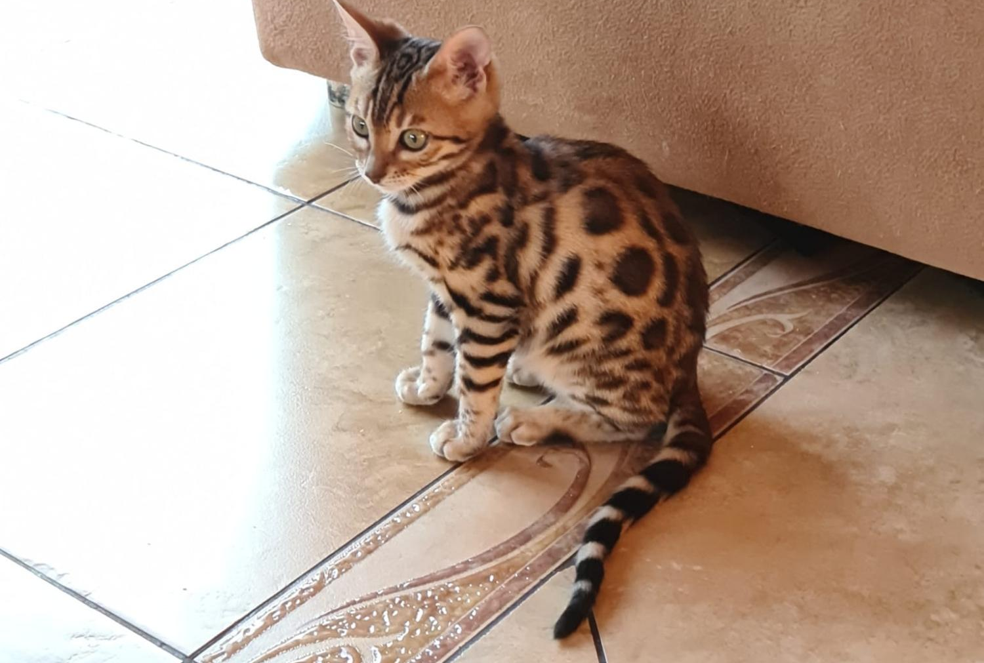
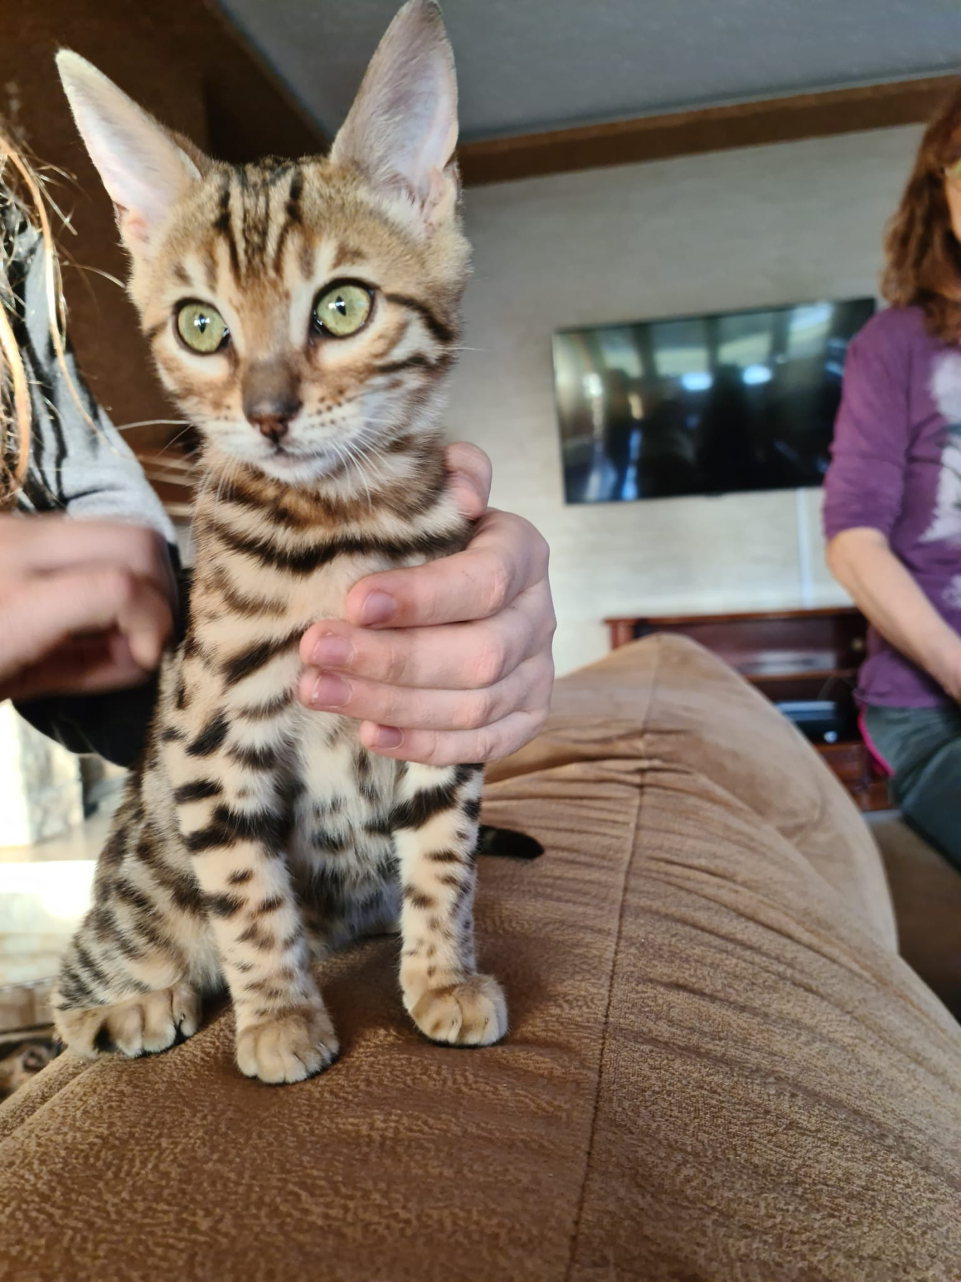
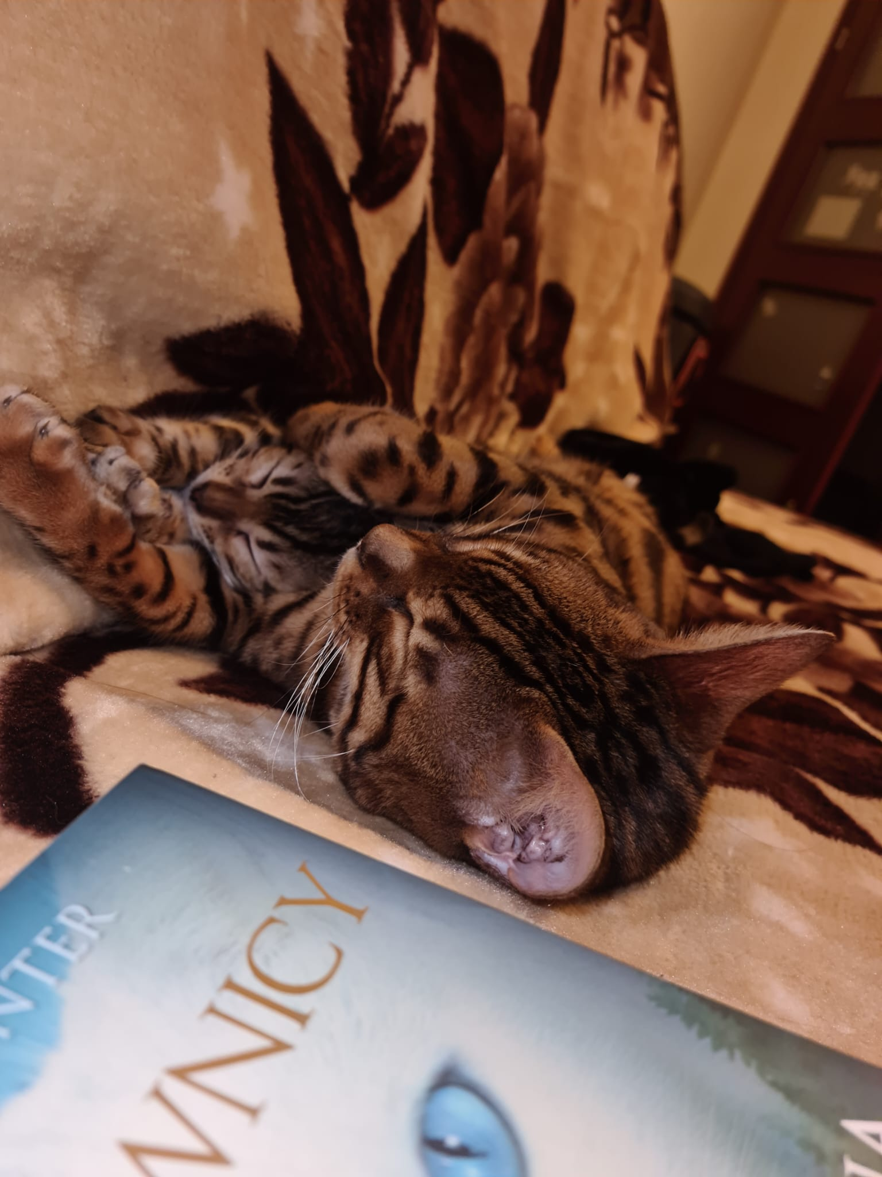
Introduction
Some are more than just days—they become memories we never forget. One of those days for me was in 2021, when I got my cat.

Slide 3
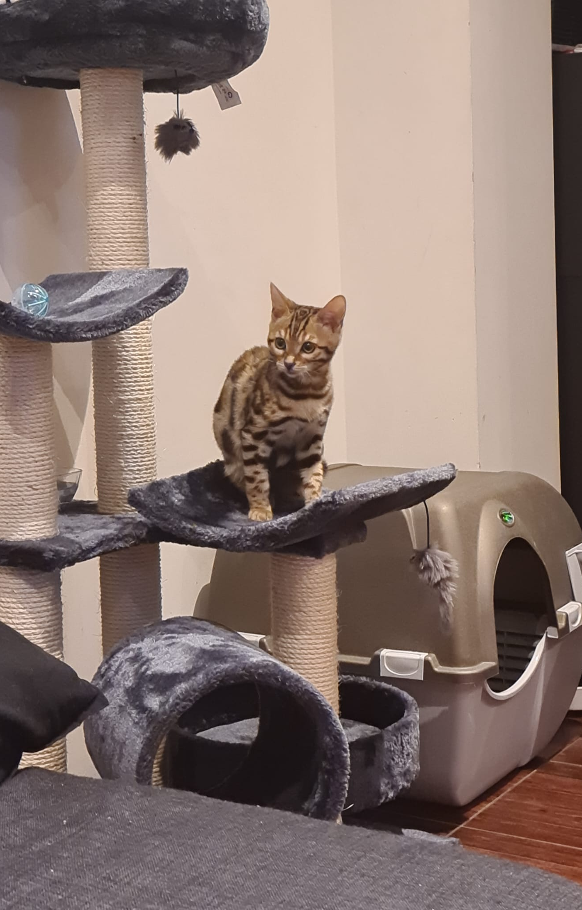
When and Where
Year: 2021
Place: Wrocław, Poland
I bought my Bengal cat from a breeder in Wrocław.

Slide 4
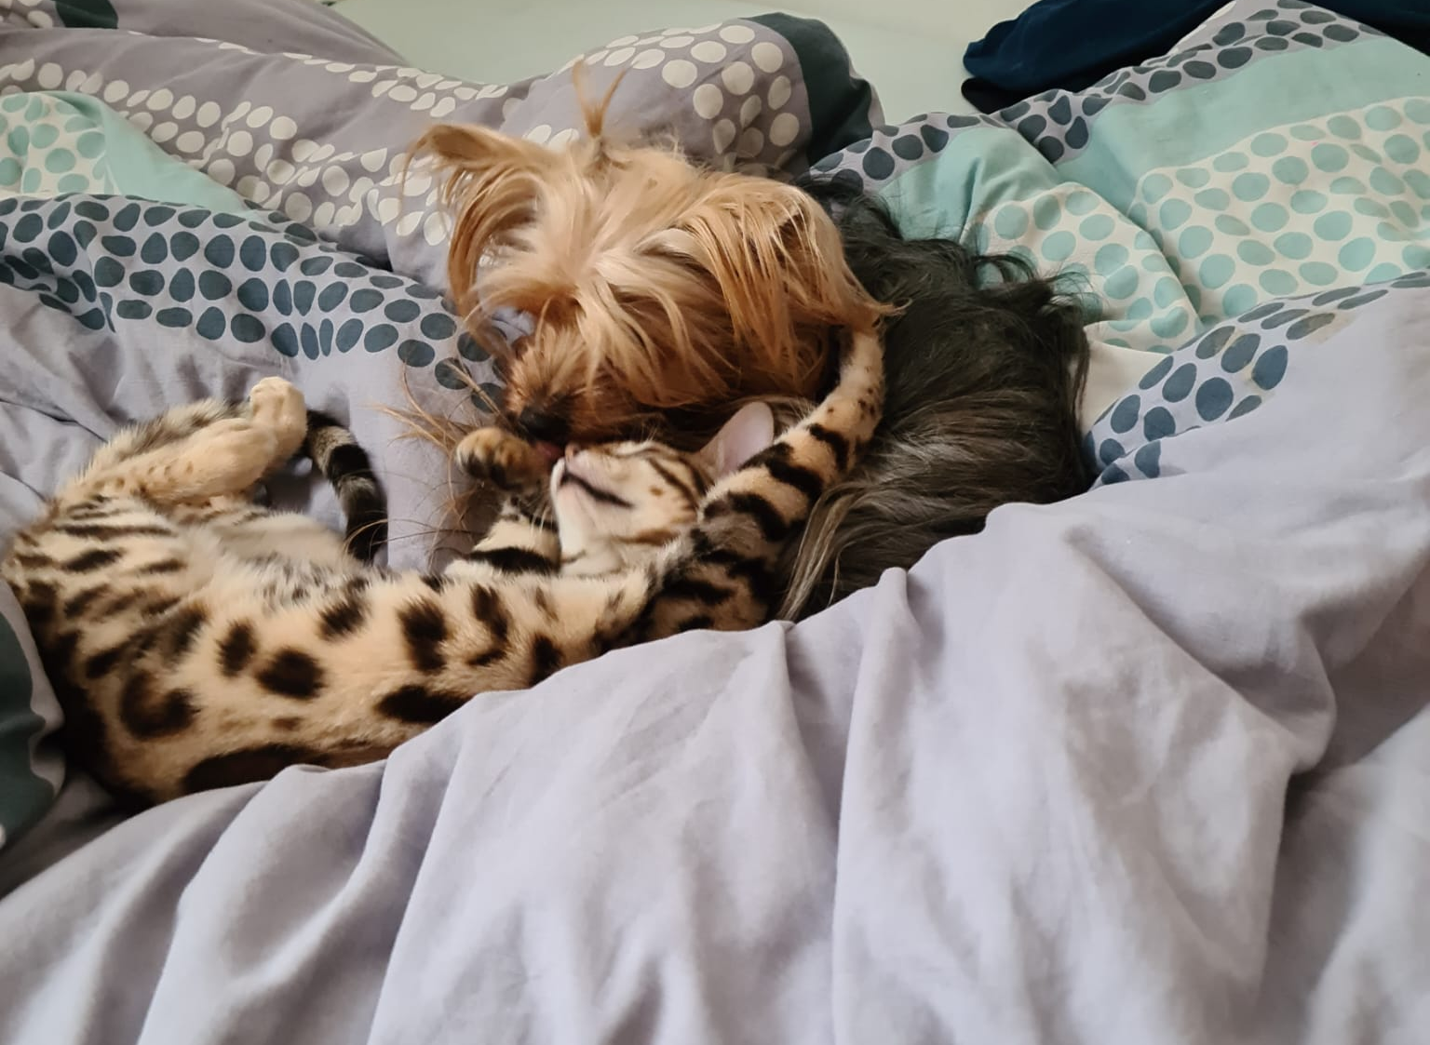
Why a Bengal cat?
I had always loved animals—especially cats. Bengal cats are beautiful, active and intelligent. After lots of reading and searching, I knew I wanted one.

Slide 5
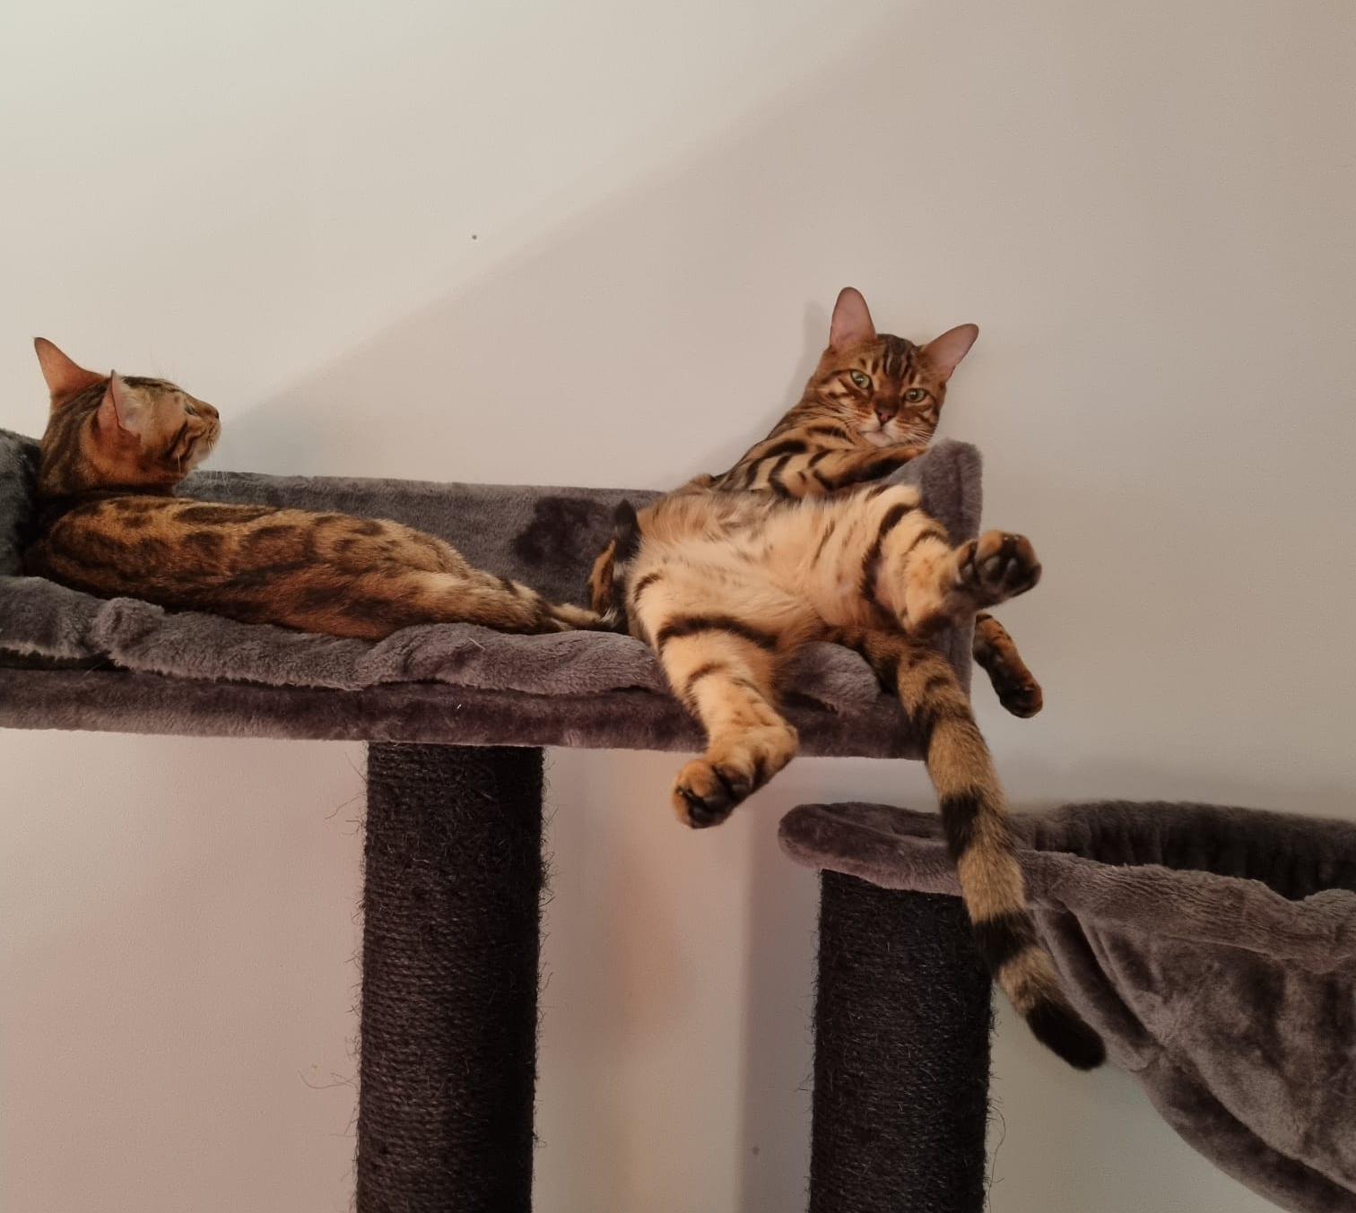
Meeting Sol.
His name is Sol. He had shiny spotted fur, bright eyes and a curious personality. When I first saw him, I knew he was perfect for me.

Slide 6
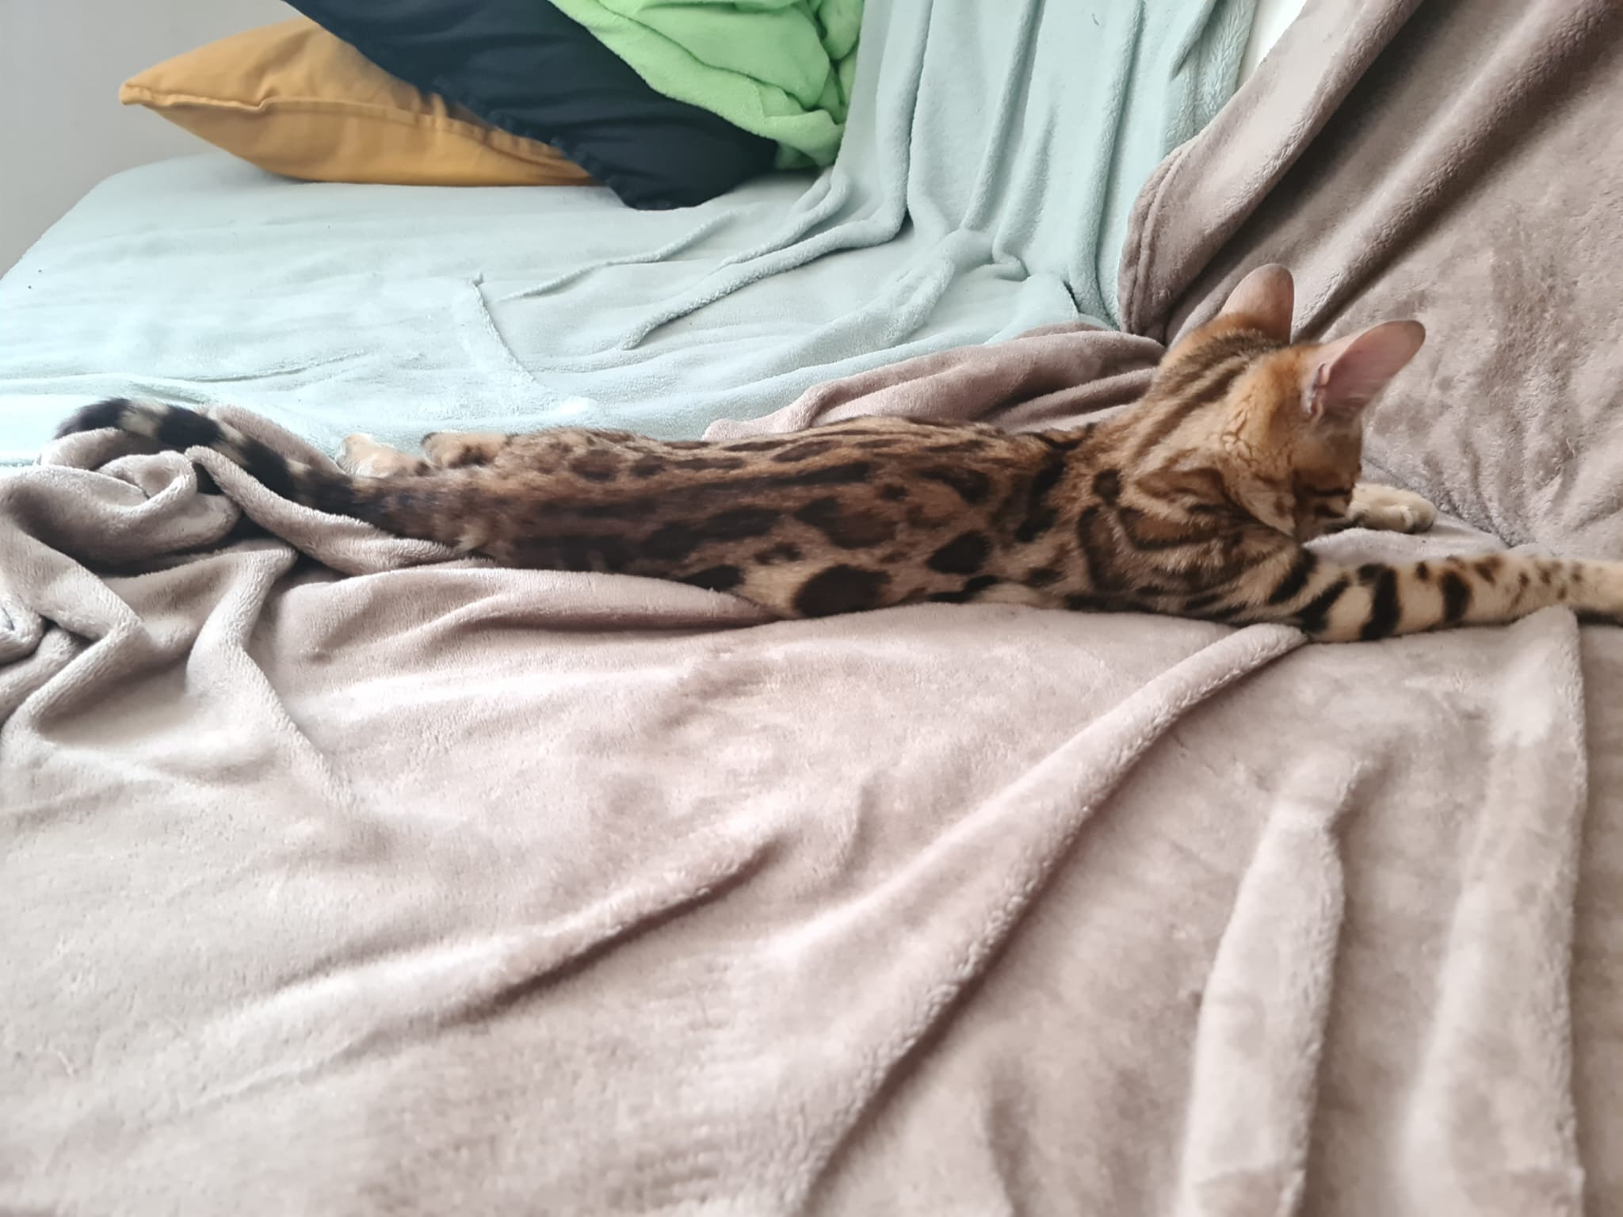
Bringing Him Home
We brpught Sol to our home in Wałbrzych. At first, he was shy and hid under the furniture. But soon, he started exploring and feeling comfortable.

Slide 7
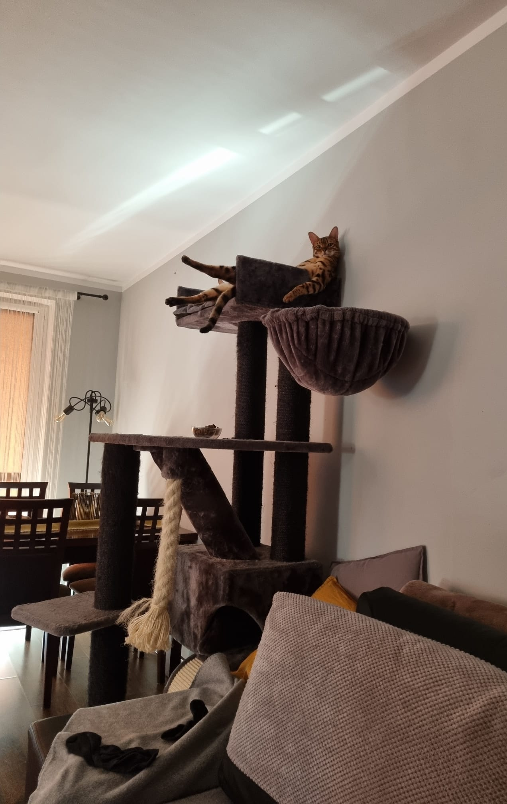
Getting to Know Each Other
Sol explored every room, chased toys and made me laugh. He followed me everywhere. He quickly became part of my everyday life.

Slide 8
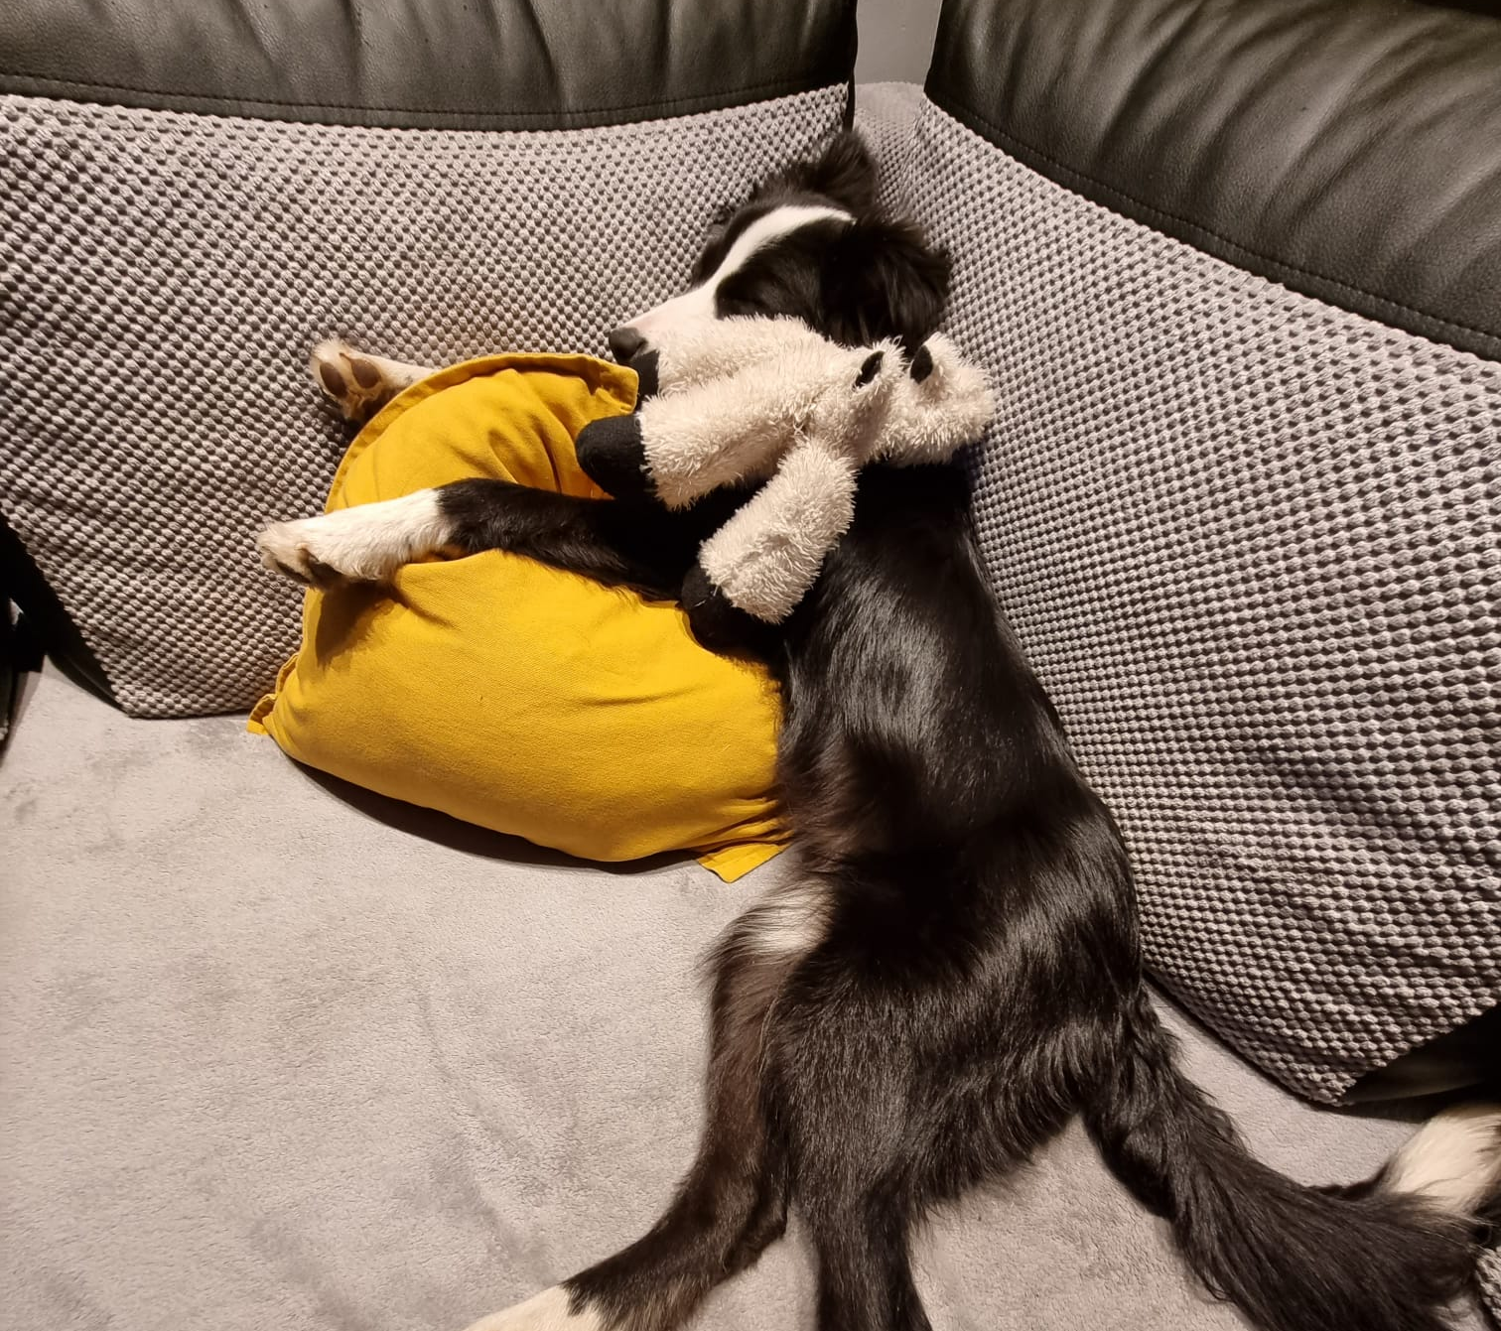
What I felt
That day, I felt happy, excited, lucky to have a such an amazing cat.

Slide 9
Why I will Never Forget That Day
Sol changed my life. He made my home warmer and my days brighter. That day was the beginning of a special friendship.

Slide 10
Conclusion
The day I got Sol will always stay in my heart. He's not just a pet—he's my best friend.
Thank you for listening!

