Slide 1
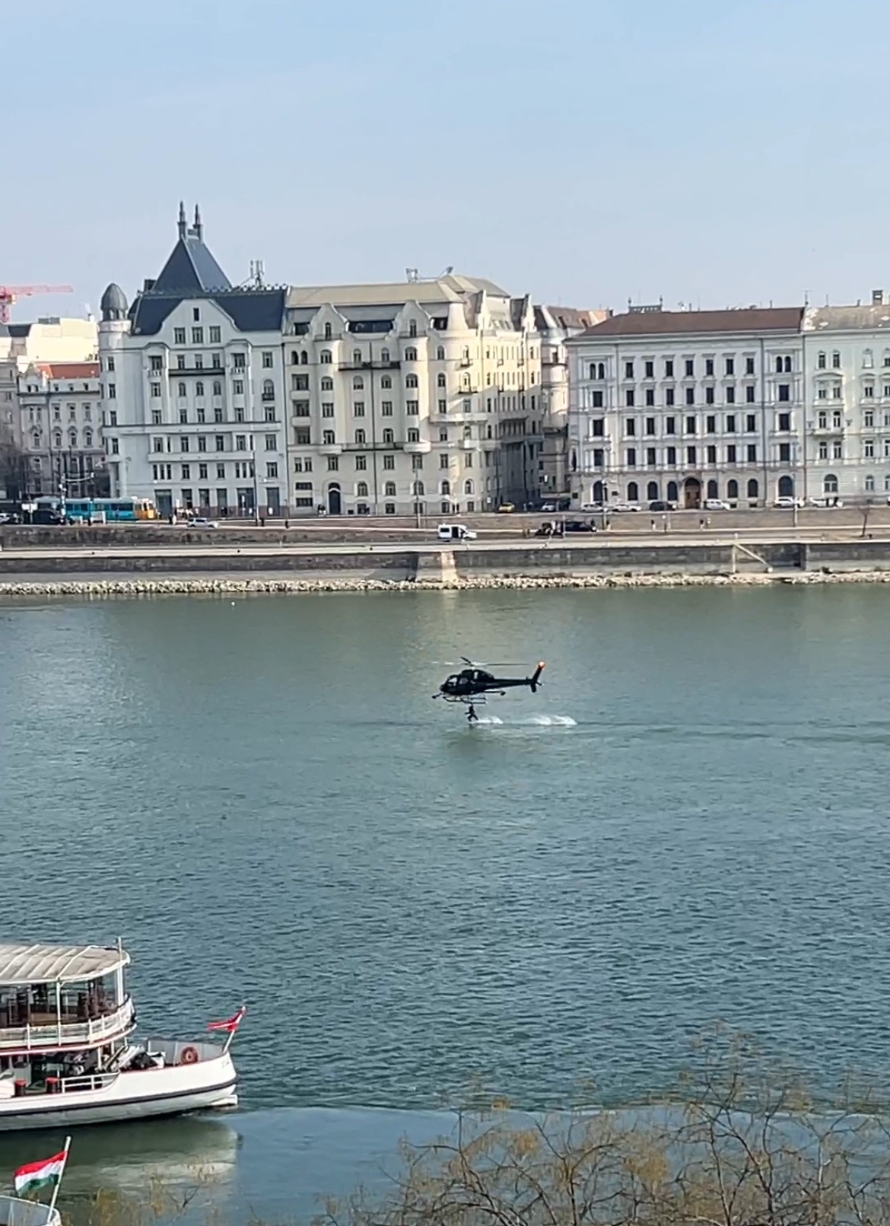
A day I will never forget
Paweł Stroisz kl. 8b

Slide 2
Amazing experience
The day I will definitely not forget was the first day of my trip to Budapest! You will find out why in a moment, but first a few words about the attractions in Budapest.

Slide 3
Yellow trams & Yellow taxis
In the whole of Budapest every tram is yellow, some are historic, others are modern

Slide 4
Yellow trams & Yellow taxis
Like trams, all taxis in Budapest are yellow. It's a bit like New York

Slide 5
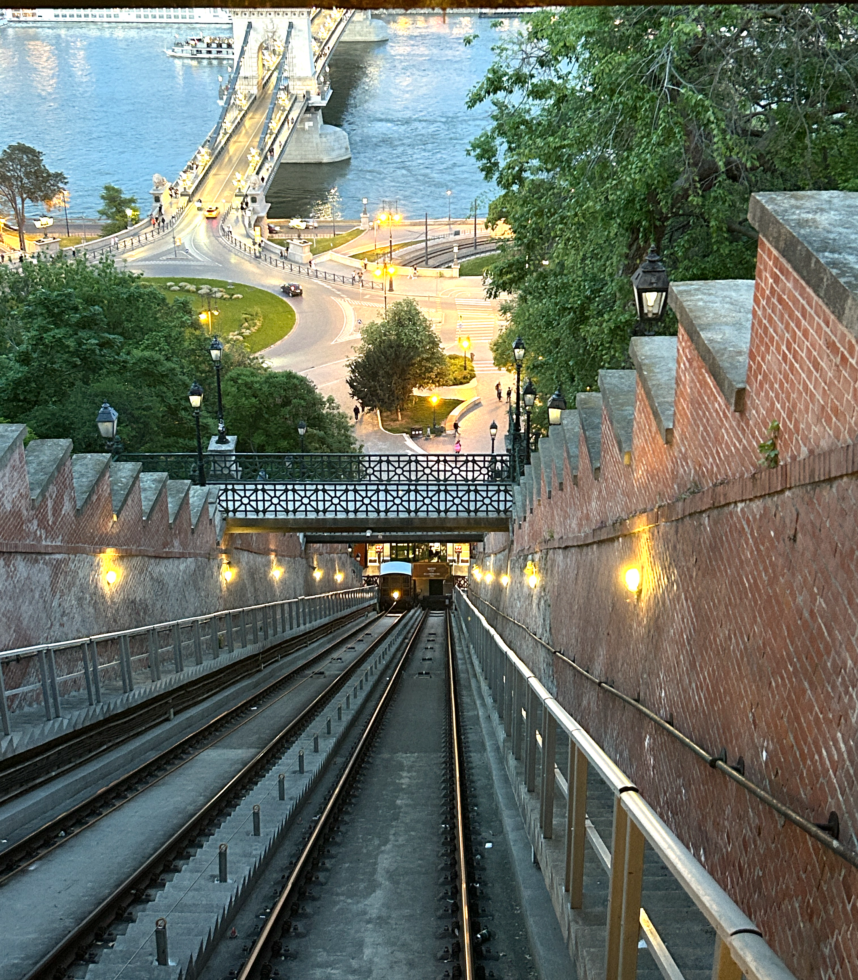
Buda Castle Funicular
The "siklo" train is great, riding it you can admire the whole panorama of the city and the river. I really liked this ride

Slide 6
The last steam locomotives and a ride
An unusual sight was a 200-year-old steam locomotive, which on selected days pulls passenger carriages behind it
The ride was pleasant, although at times it smelled of burning coal.

Slide 7
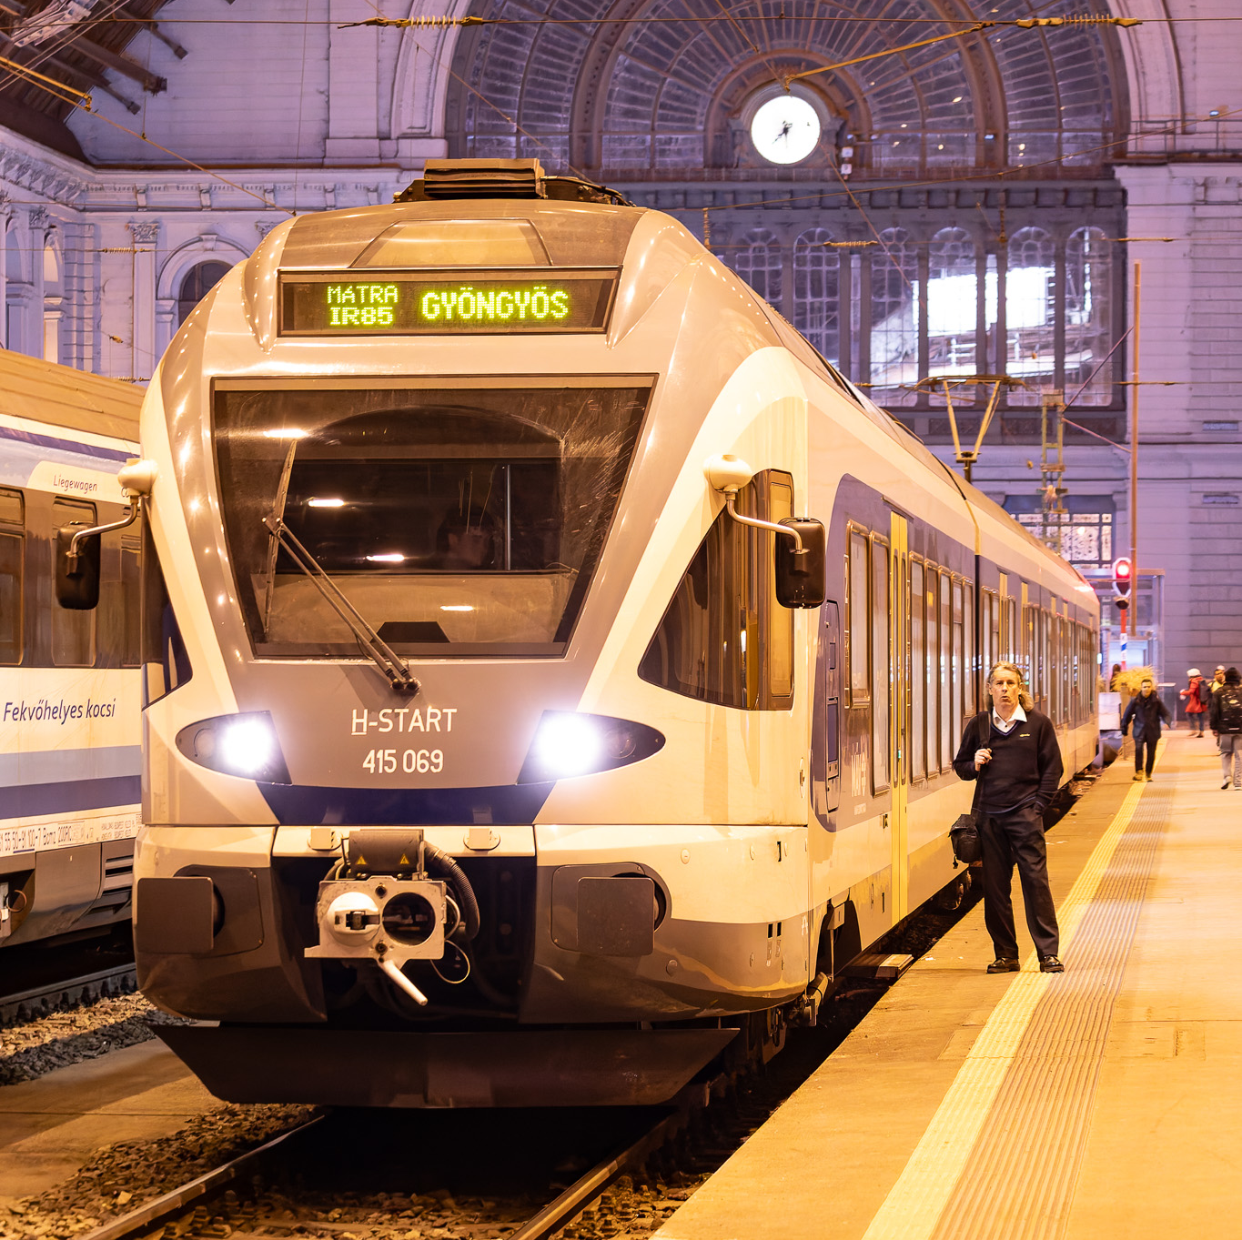
Not only steam locomotives
Fortunately, the railway in Budapest is not just steam locomotives. The railway infrastructure is very well developed.
Modern locomotives stand inside beautiful, historic railway stations

Slide 8
The Danube and its beautiful bridges
The Danube, a great river, flows through the whole of Budapest. There are historic bridges over the river, on which cars drive and you can also walk.

Slide 9
Rescue operation on the Danube?
After dinner I wanted to rest in my hotel room. Unfortunately I couldn't. A rescue operation began right outside the hotel windows. I didn't know what was happening.
Two helicopters were flying over the Danube River. I was convinced that one of them, the blue one, belonged to Television.

Slide 10
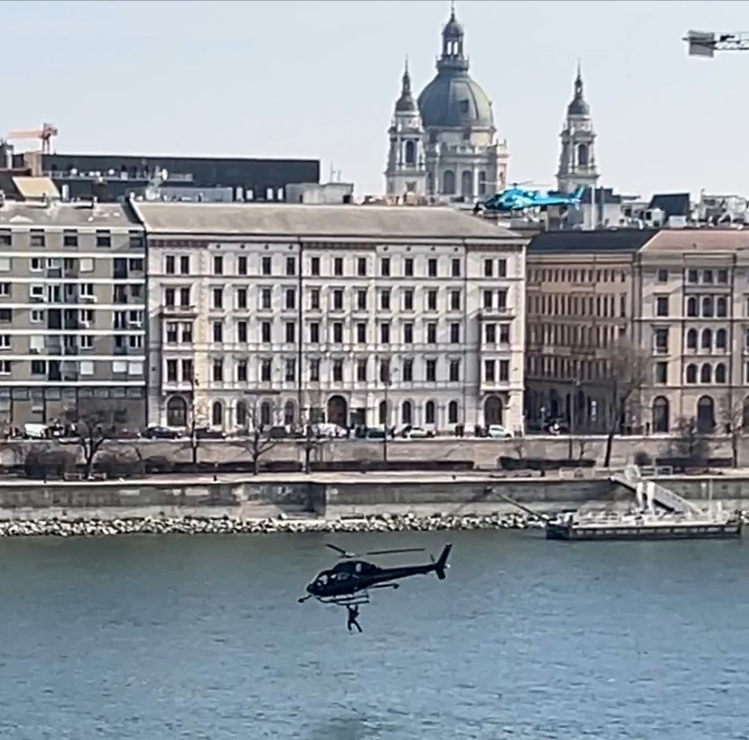
Scenes for the movie MATCHBOX
Luckily, no one was hurt. It turned out that the movie MATCHBOX was being filmed right under my room's windows. It was a great spectacle.

Slide 11
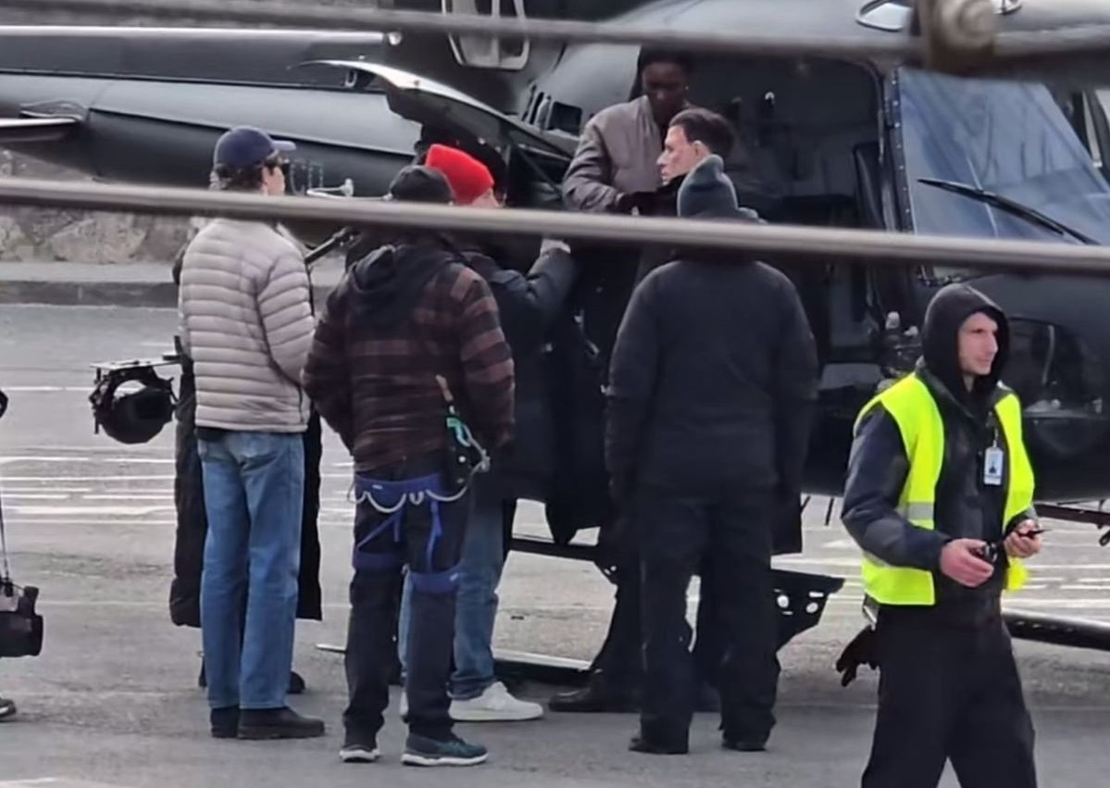
John Cena
The main role in the film is played by John Cena, American wrestler and actor. Now I am waiting for the movie to come out in cinemas so I can watch it.

Slide 12
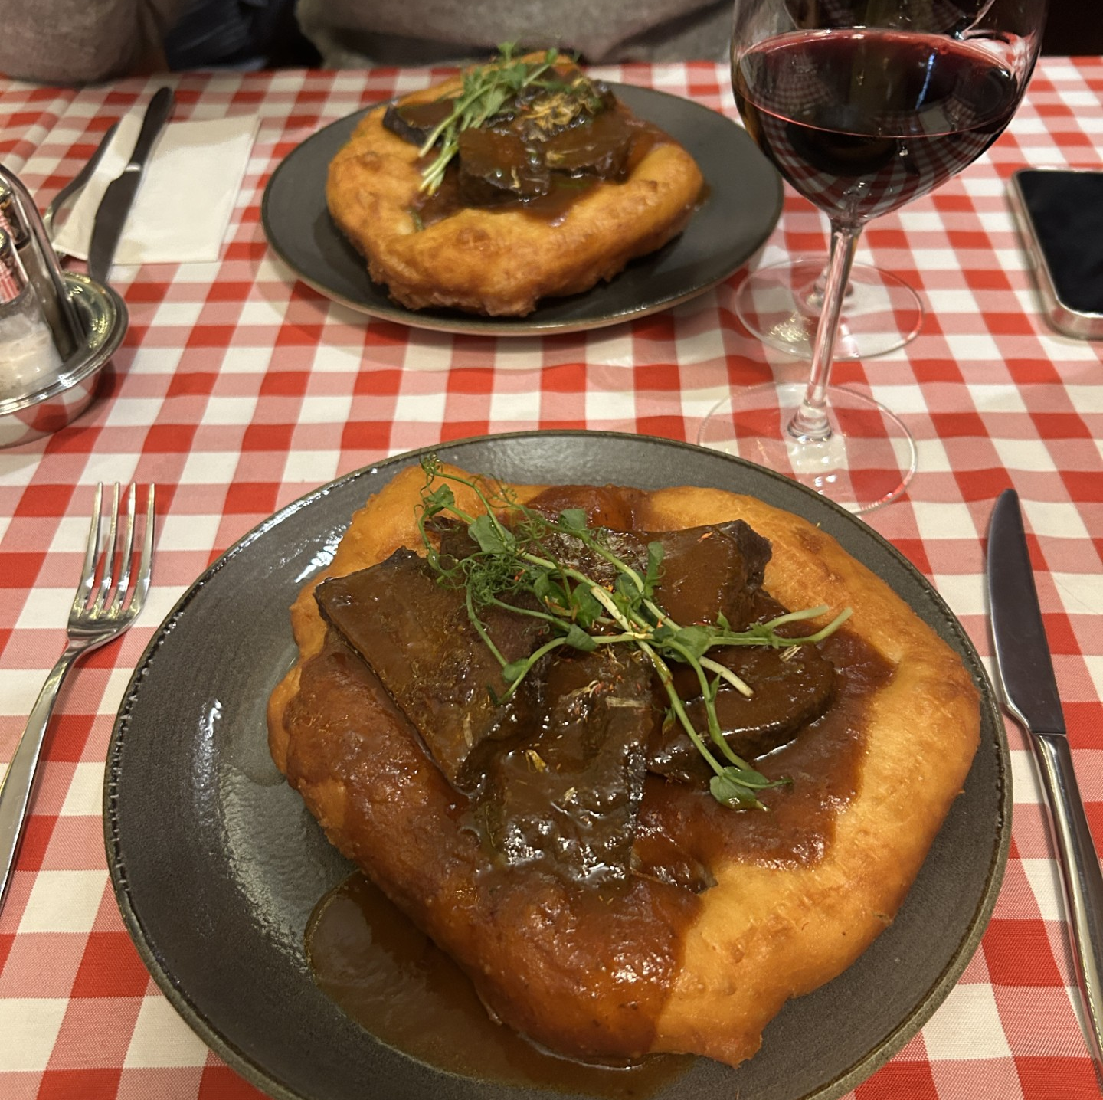
Langos to end the day
After a day full of emotions I ate dinner a Hungarian delicacy – langos and went to sleep. The best day in my life was the day when I saw and visited Budapest for the first time. Despite the long and tiring journey I was enchanted by the extraordinary view of the city.

Slide 13
Thank You for your attention

