Slide 1
Dancing is my hobby.
Iga Pawlikowska Va

Slide 2
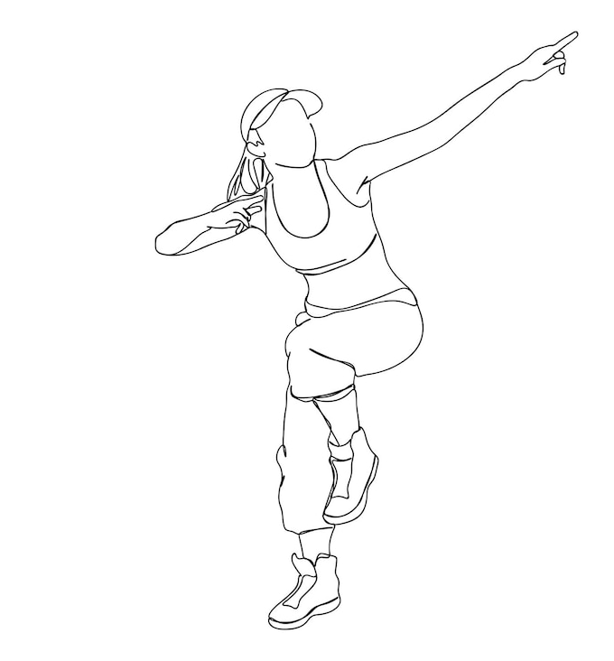
My favorite dancing style is Hip-Hop.
Because when I had seven years I went on a dance camp on holidays. I liked it very much. I decided i will go nexy year too. After the second trip I wanted to dance. My mom agreed so I started dancing. I love it.

Slide 3
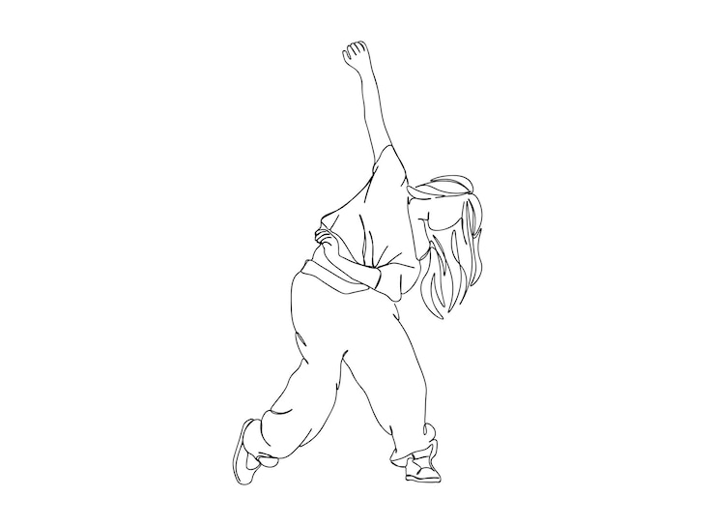
Hip-Hop beginnings.

Slide 4
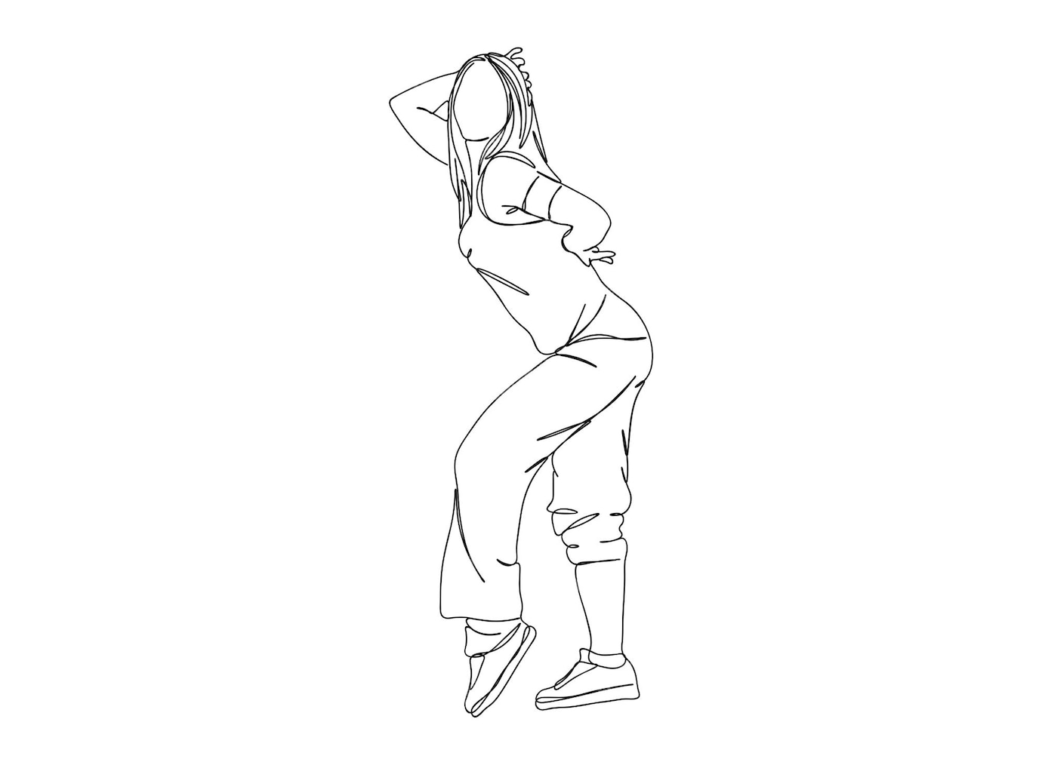
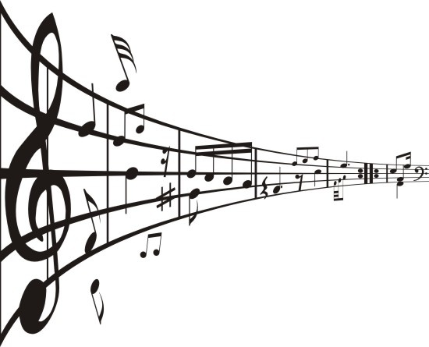
My dance school.
My dance school is Cordex. I train there every monady and friday. I like them very much, because ther is a very nice atmosphere there and I like meeting my friends. My training looks like this, we start with a warm-up, after warming-up, sometimes our teacher asks us about dance steps then we practice formations.

Slide 5
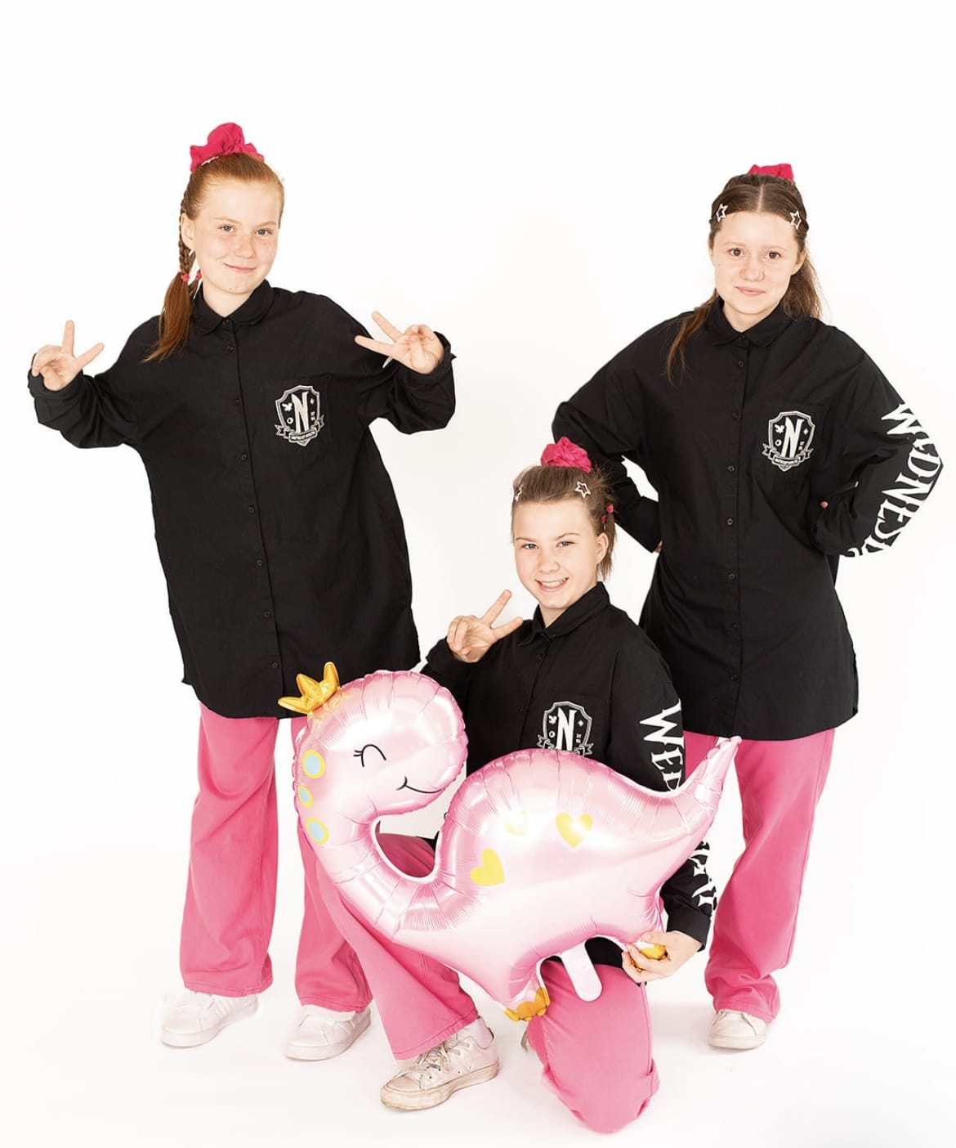
Dancing competitions.
I go to competitions with my dance school. I like these competisions because they give you a lot of experience and I have a lot of fun. I was in Piła on my first competitions and it was amazing. First was the freestail, next we practiced formations, after that we performed. Unfortunately we didn't win anything but it was still great.

Slide 6
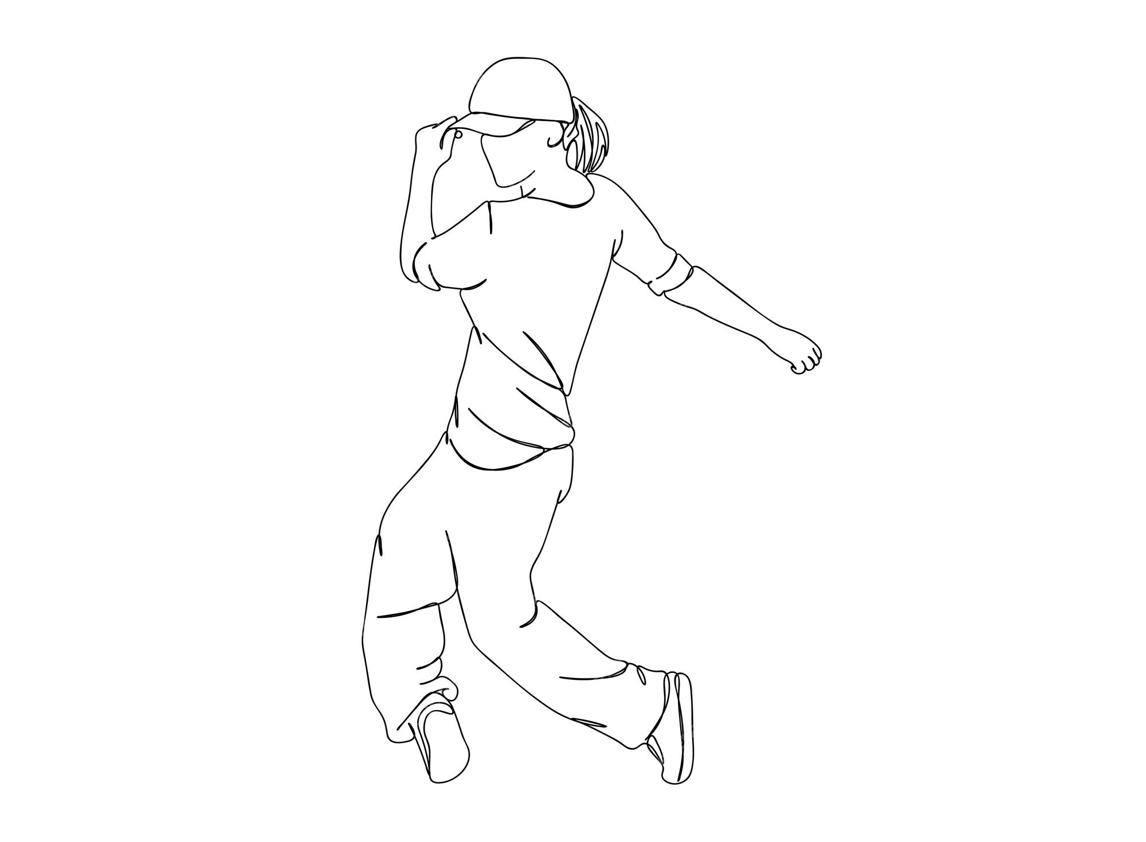
The development of Hip-Hop.

Slide 7
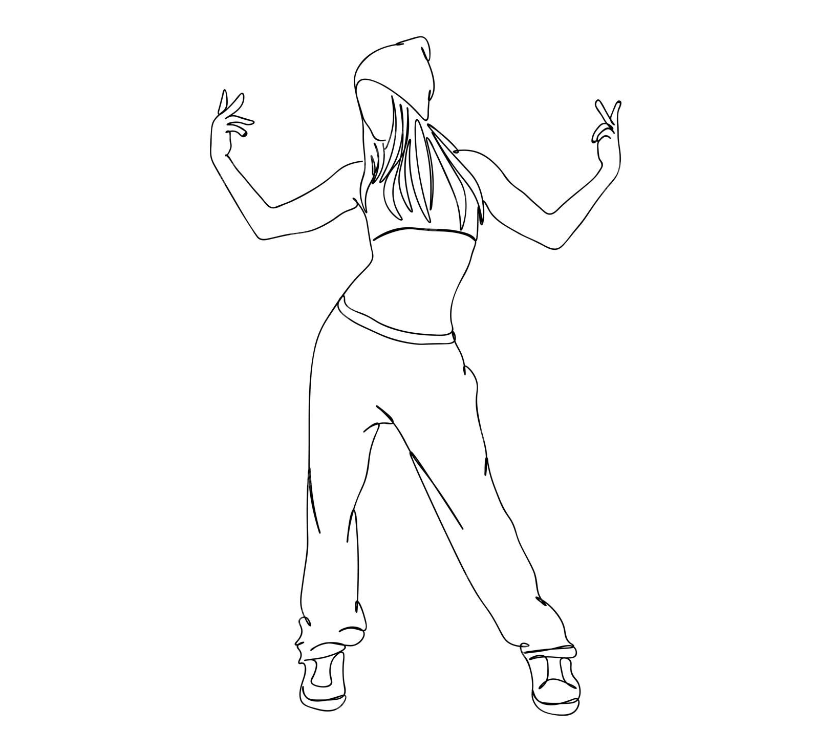
Dance steps:
Gucci
Shamrock
Stanky leg
Stomp
Bart simpson
Jannet Jackson
Popcorn
Criss-cross
Atl stomp
Basket ball
Biz marke
Cabbageptch

Slide 8
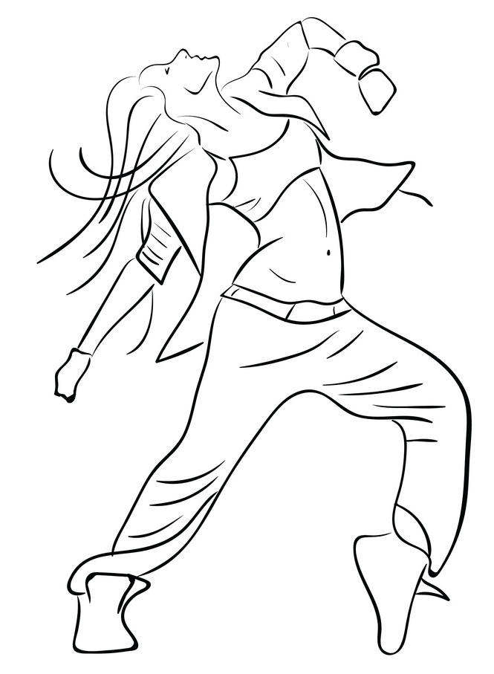
My second competitions.
My second competition was a two-day event. We got up early in the morning and went for breakfast. Them we went to the competition venue. First there was freestyle and then formations. There were different categories, for example medium and easy. It may seem that such competitions last a short time, nothing could be further from the truth, some competitions last 24 hours, for example. In this competition we took ninth place out of eleven, we were happy because it was better than last time.

Slide 9
Dance camp
My dance school organizes dance camps that I go to every year. We get up at 7:30, get ready and go for a morning warm-up. At 8:00 we have breakfast. Then we have various classes, for exemple Jazz, Hip-Hop, social traning with various dancers, swimming pool and going out to the city for example. We have various trips at the last camp we went to Gubałówka, rope park and thermal baths. For people who are at the camp we prepare camp baptism.

Slide 10
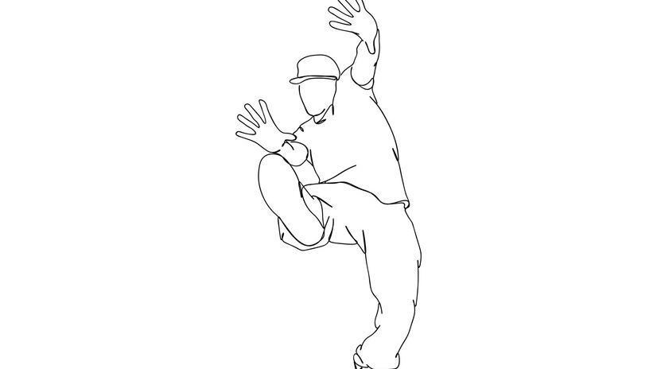
The end
Thanks for reading my presentation. Meyby you should try dancing too.

