Slide 1
A DAY I WILL NEVER FORGET
Filip Bierda VIIIa

Slide 2
BEGINNING
Hello! I would like to talk about a day I’ll never forget In my heart. It was just an casual day after school and my parents decided to surprise me with something. They told me I will be really happy about it. Of course I got really excited about that!

Slide 3
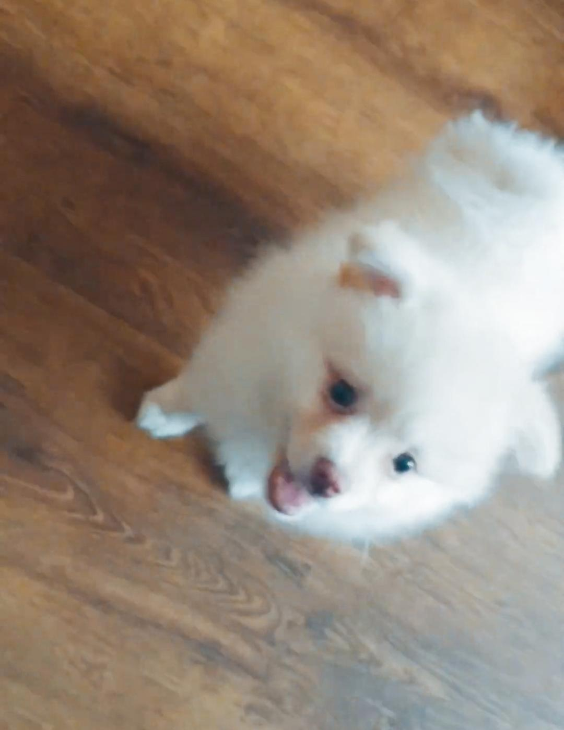
I got a dog!

Slide 4
Yes, I’ve gotten an dog, and I decided to name him Charlie. He’s an Pomeranian Spitz breed.
When I got him, he was around 1-2 months of age, currently he is almost 5 years old!

Slide 5
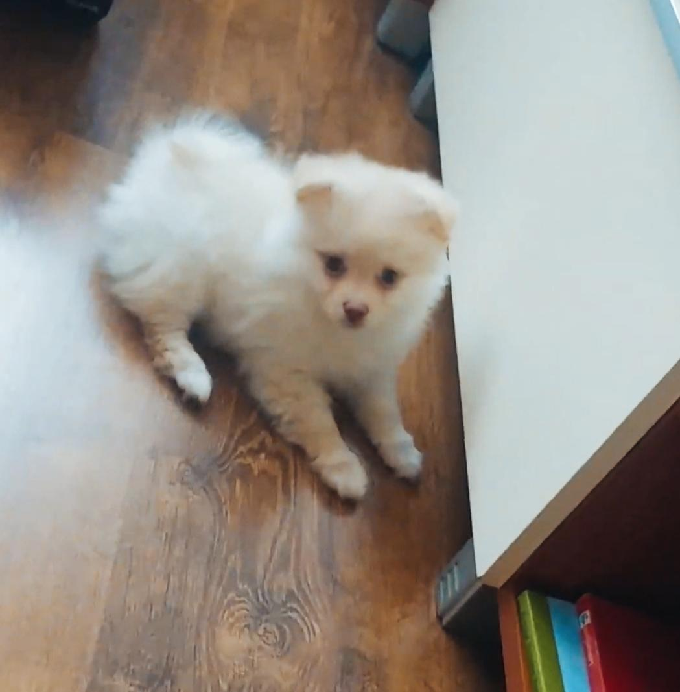
ABOUT MY DOG
My dog is an Pomeranian Spitz breed as I mentioned before, he’s also an pretty huge dog for his breed, and also his fur is in a bisquit like colour.

Slide 6
That day, when I got my dog, I was really happy. I’ve always wanted to have a pet and to take care of one. We once had a cat, but sadly the cat has escaped and has never been seen since...

Slide 7
I am really happy that I still have him. He is so funny! When he was still young, he used to get into small spaces around my house and was trying
to hide away from us, but when we found him, he would run away from us!

Slide 8
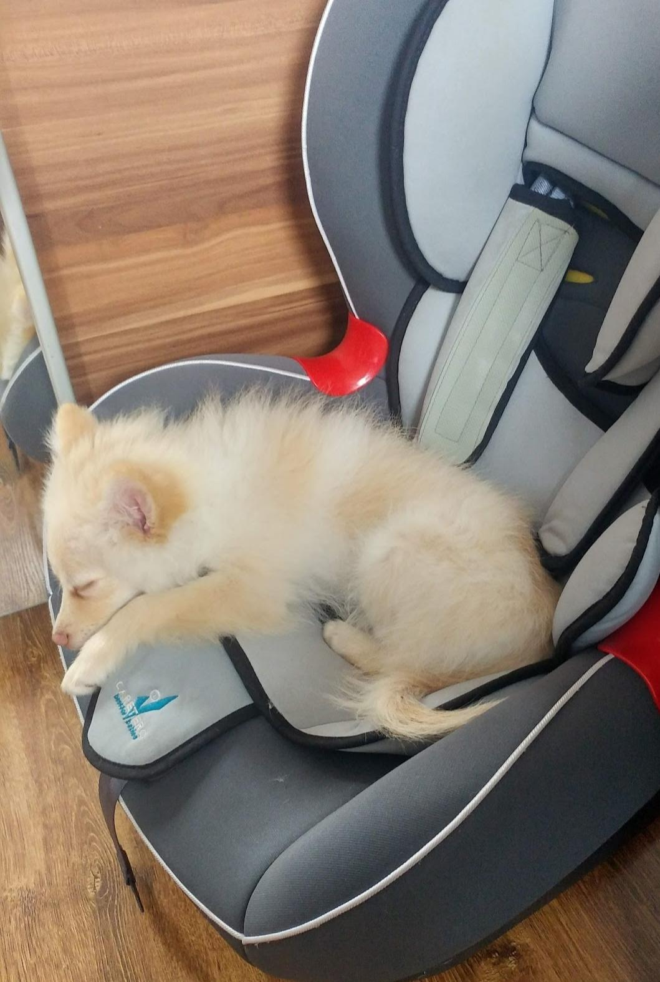
Something that I want to also mention was during COVID-19 we used to stay isolated in homes to avoid getting sick. During that time it was very boring, but with our dog, we played with him and didn’t spend our time laying on our beds.

Slide 9
Also, during the lockdown, we used to do PF with webcams, often during our exercises my dog would get into my room and start bitting me wanting to play with me. I still remember that like it was yesterday!

Slide 10
CURRENT STATE
For the most part, I talked about my dog when he was still small. I want to say that he is still silly and also funny, but he is way bigger now, and heavier.
He used to weight only 500 grams!

Slide 11
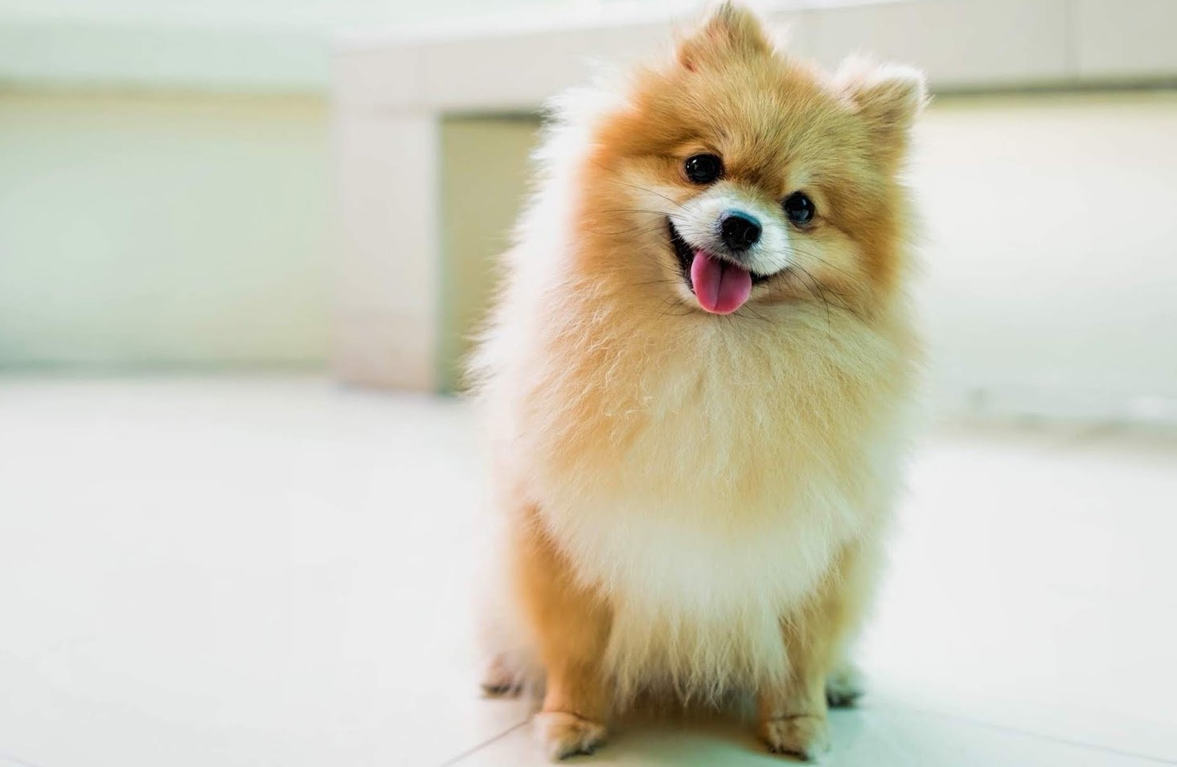
THE END
Thanks for watching my presentation! I hope you
enjoyed it.

