Slide 1


Swimming
my hobby

Slide 2

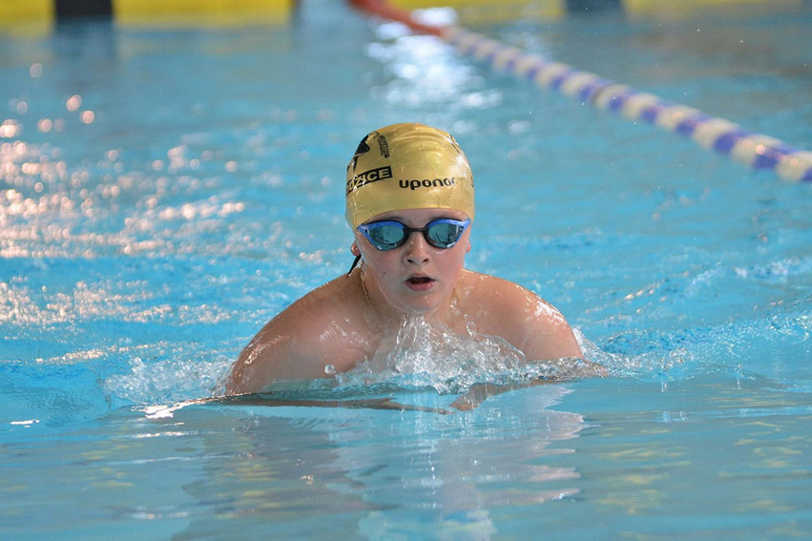
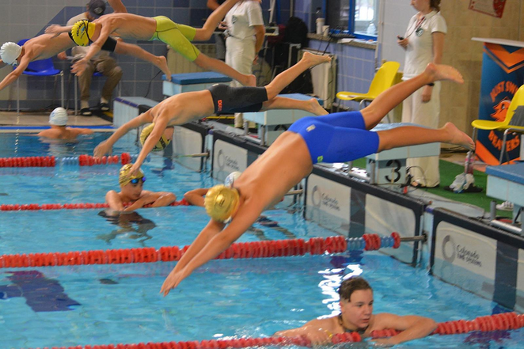
My favourite sport is swimming.

Slide 3
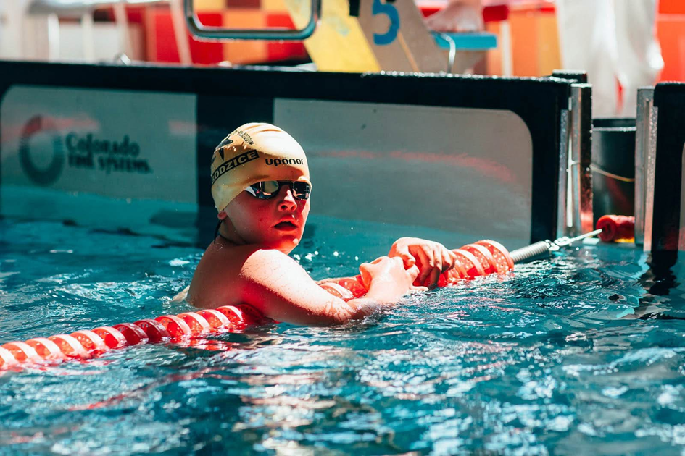
I do it very long- about 10 years.
Now I swimm 6 days a week, in the morning and after school. It is 12 hours a week.

Slide 4

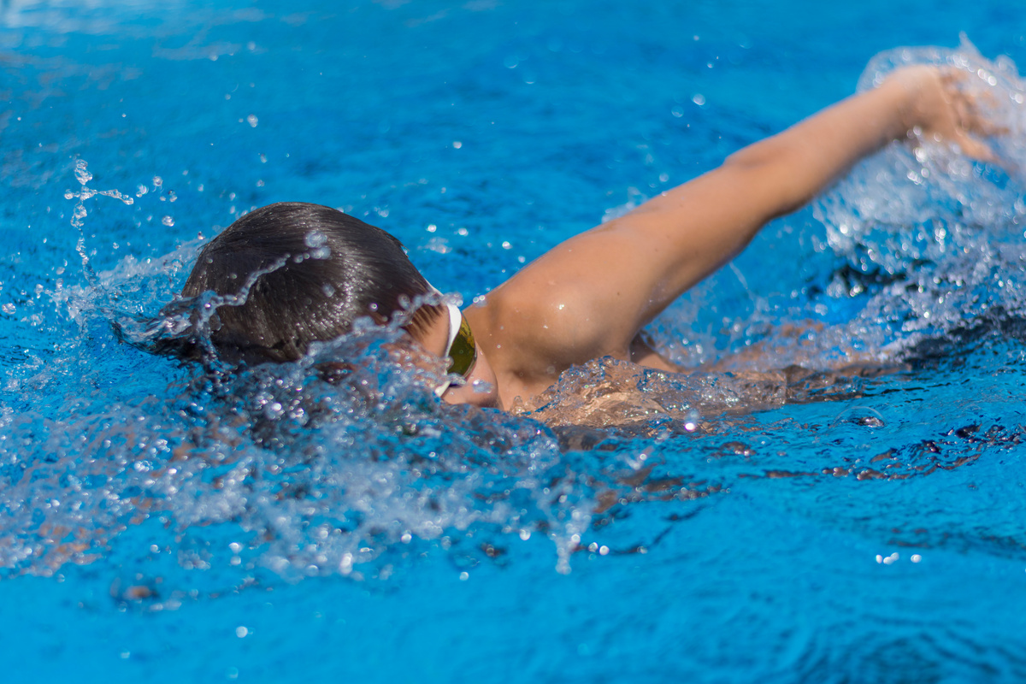
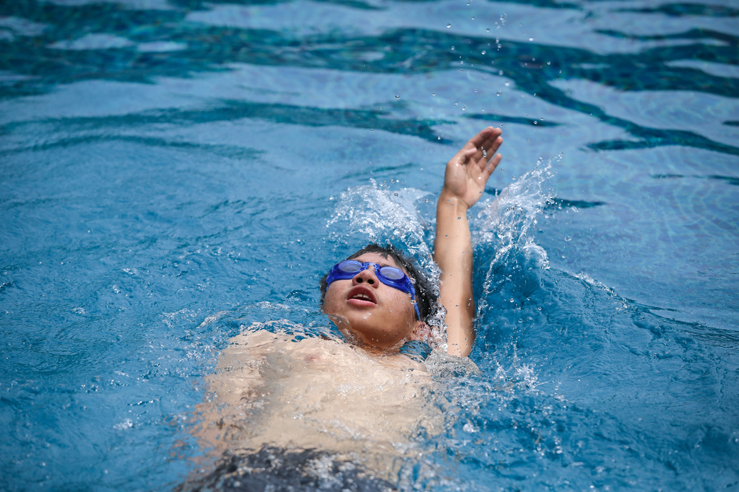
Basic Swimming Strokes
Freestyle (Front Crawl)
Backstroke

Slide 5
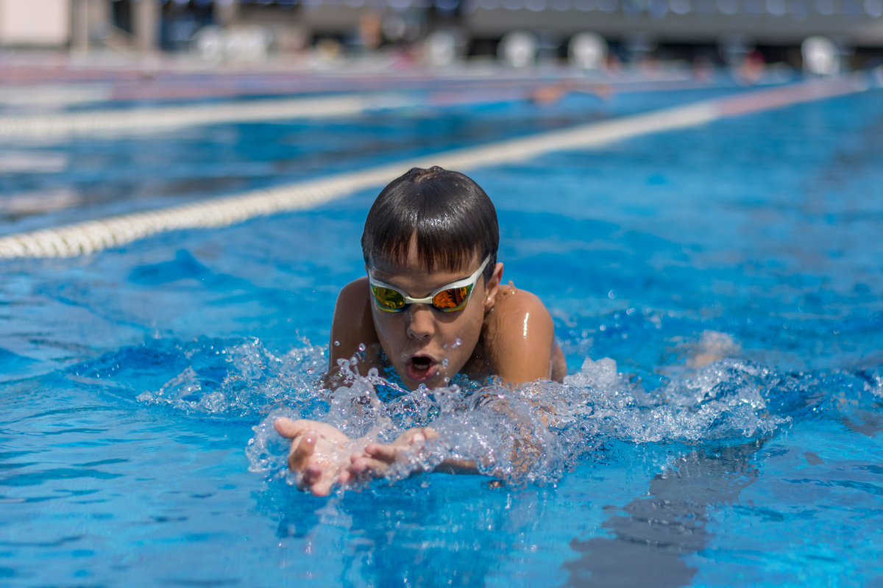
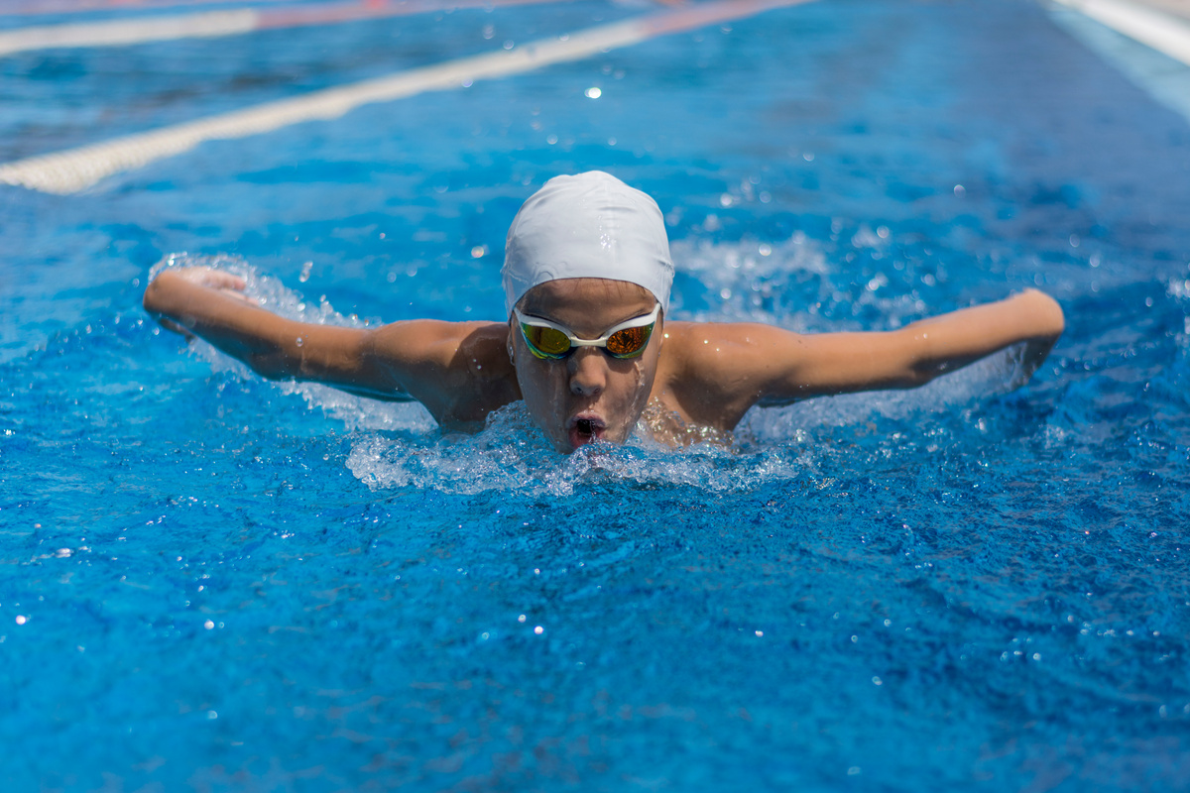
Basic Swimming Strokes
Breaststroke
Butterfly

Slide 6


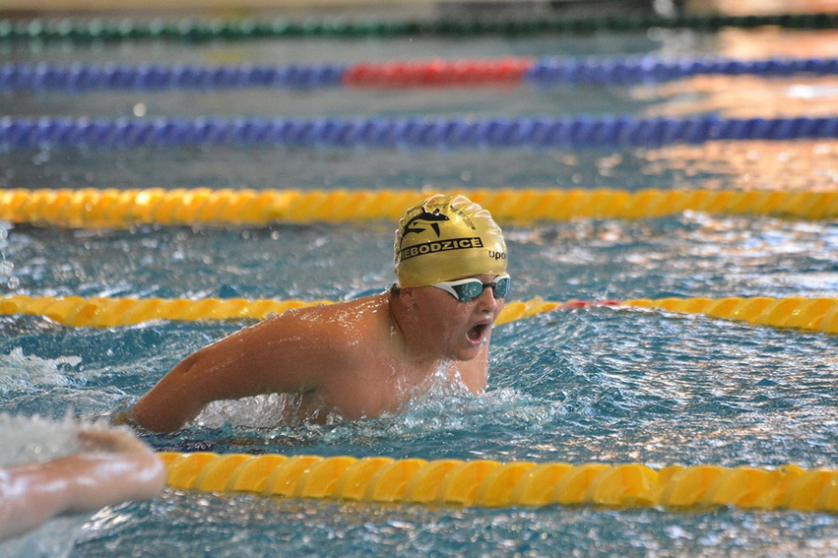
My favourite style is backstroke

Slide 7
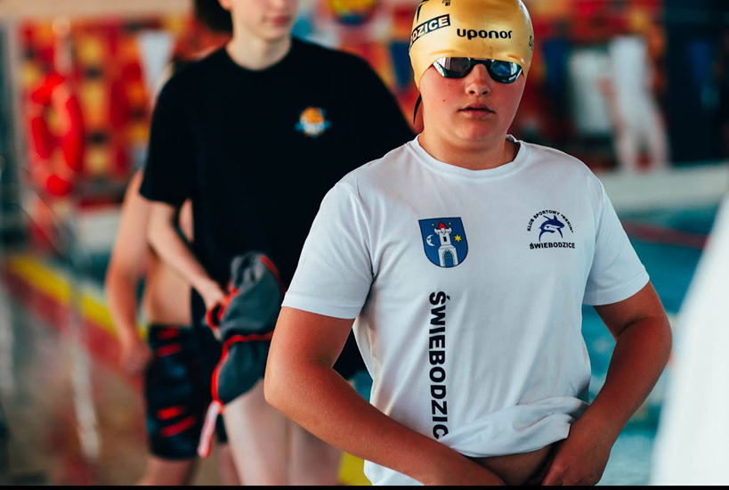

My team’s name is „Rekin Świebodzice”.

Slide 8

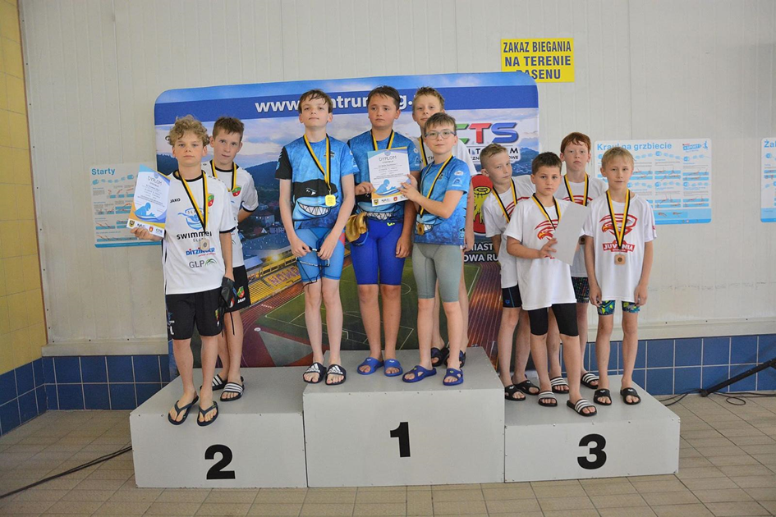
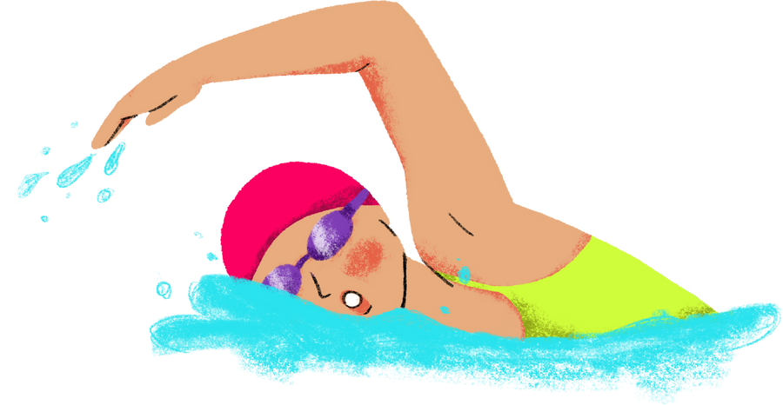
My team and I go to competitions and I win sometimes.

Slide 9
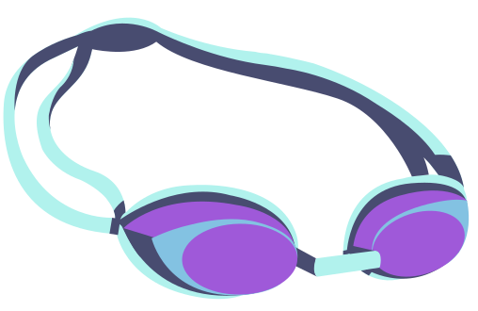

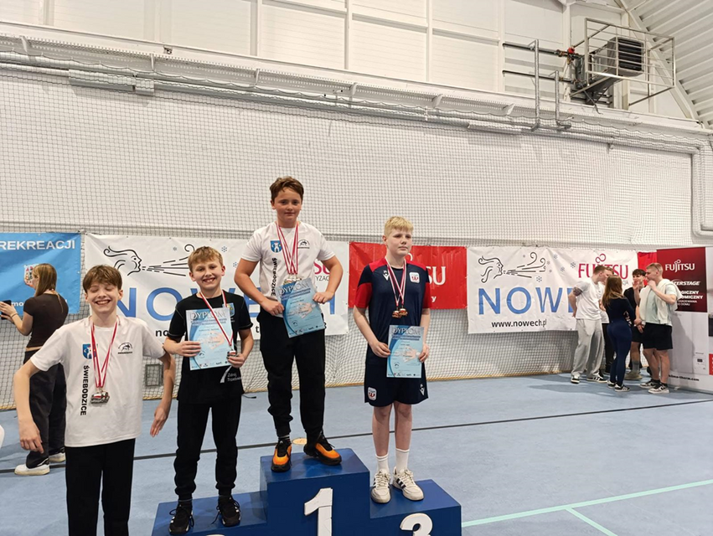
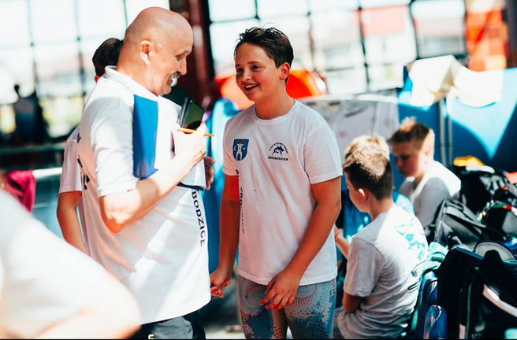
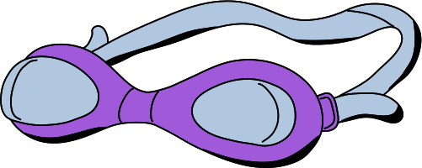
Swimming is very good for body and brain.
I feel good after trainning.
It is my coach.

Slide 10
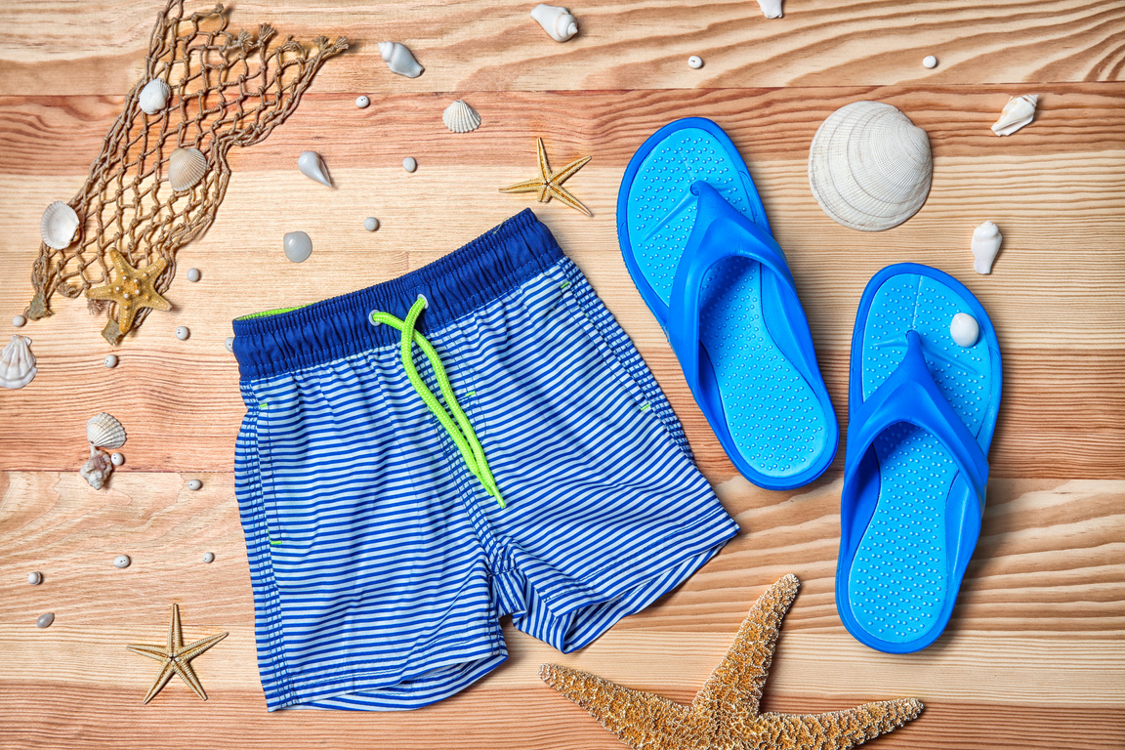
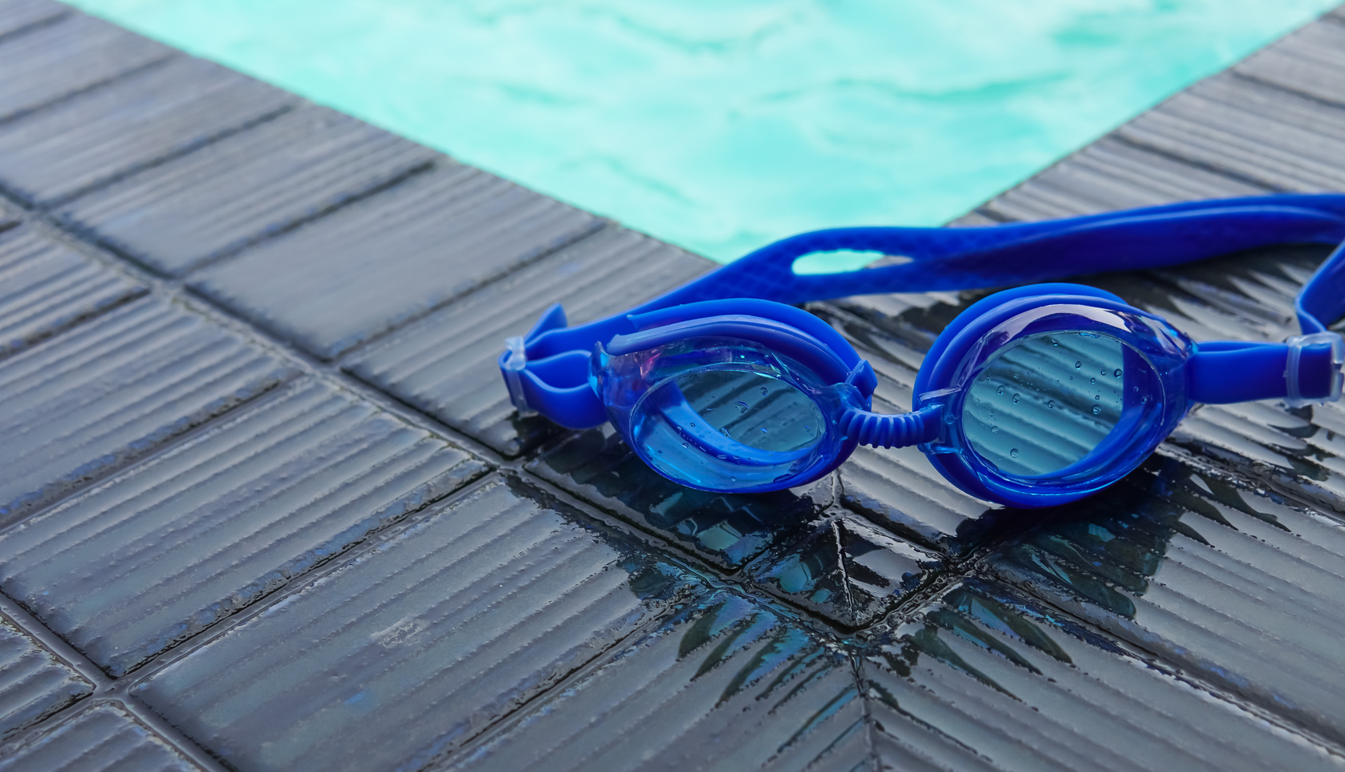
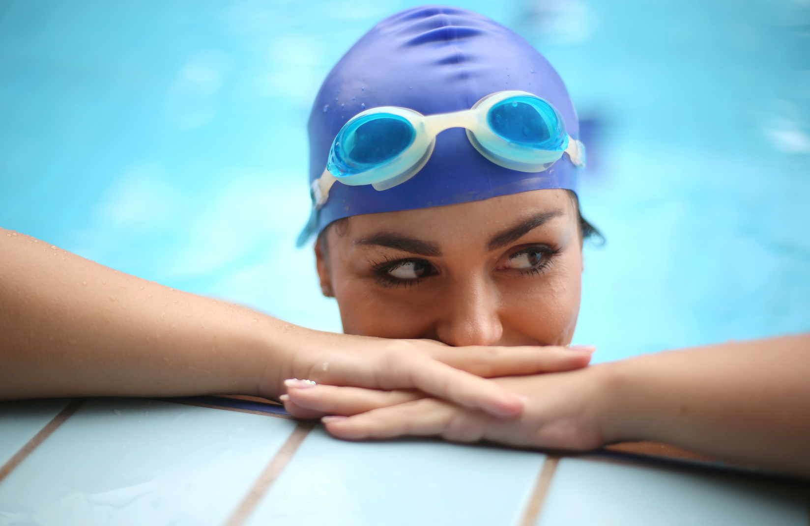
Equipment for Swimming
Swimwear
Goggles
Swim Cap

Slide 11
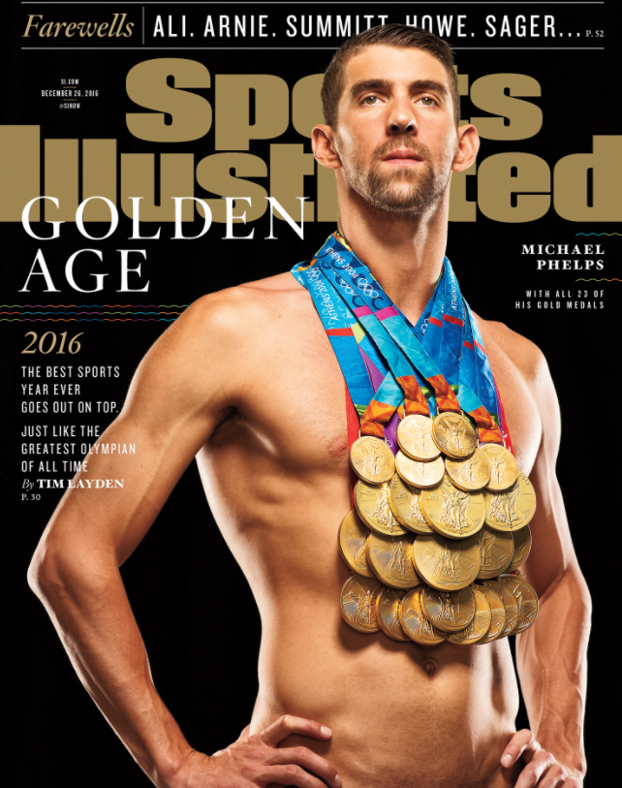
My favourite sportsman is Michael Phelps. Hei is from the USA. He is teh best swimmer in history. He is amazing! He won 28 medals on Olympic Games and 82 medals in his whole career.

Slide 12
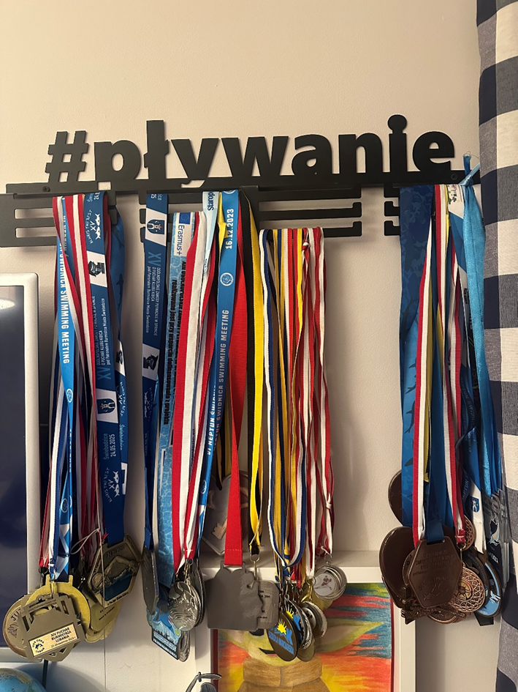
I want to be the best like him so I swim a lot. Now I have about 50 medals and diplomas.

